Slide 1
Splunk Modern Application Development Workshop
Tom Martin | Staff ITOA Practitioner Domnick Eger | Global DevOps Practitioner

Slide 2
Safe Harbor Statement
During the course of this presentation, we may make forward looking statements regarding future events or the expected performance of the company. We caution you that such statements reflect our current expectations and estimates based on factors currently known to us and that actual events or results could differ materially. For important factors that may cause actual results to differ from those contained in our forward-looking statements, please review our filings with the SEC. The forward-looking statements made in this presentation are being made as of the time and date of its live presentation. If reviewed after its live presentation, this presentation may not contain current or accurate information. We do not assume any obligation to update any forward looking statements we may make. In addition, any information about our roadmap outlines our general product direction and is subject to change at any time without notice. It is for informational purposes only and shall not be incorporated into any contract or other commitment. Splunk undertakes no obligation either to develop the features or functionality described or to include any such feature or functionality in a future release.

Slide 3
Technology Level Set
Docker & docker-compose
Buttercup-Go: a Node.js application
Login: Auth0
DevOps: CI/CD
Source Code Control: Git & Bitbucket
Build Automation: Jenkins
Application Monitoring
Logging : Splunk Javascript Logging + HTTP Event Collector (HEC) … or Mint.js!
End User Monitoring: Boomerang.js + HEC
APM Tools: New Relic

Slide 4
Today’s Lab Outline
Introduction
Buttercup-Go!
Modern Application Architecture
DevOps Tooling & Monitoring
How it all fits together
Why?
Hands-On
Module 1: Installation
Module 2: Environment verification
Module 3: Modifying the game’s images
Module 4: Adding end user experience with HEC
Module 5: HEC in a High Volume Environment
Module 6: Adding an APM Tool – New Relic
Module 7: Examining gaming (business) metrics
Module 8: Feedback on this workshop

Slide 5
Buttercup-Go
A quick introduction to our application

Slide 6

Buttercup Go!
Give it a try!
https://buttercup.rocks/
How did you do?

Slide 7
Modern Architecture
The Technology behind the application

Slide 8




Buttercup Go Technology Layout
NGINX
APP SERVER
APP SERVER
BITBUCKET
JENKINS
Source Code Management
Build Toolset
Jenkins Build Slaves

Slide 9
Buttercup Go Workshop Layout
Docker Network (appdev_workshop)
APP SERVER
BITBUCKET
JENKINS
Source Code Management
Build Toolset

Slide 10
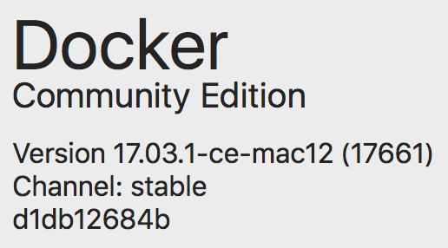
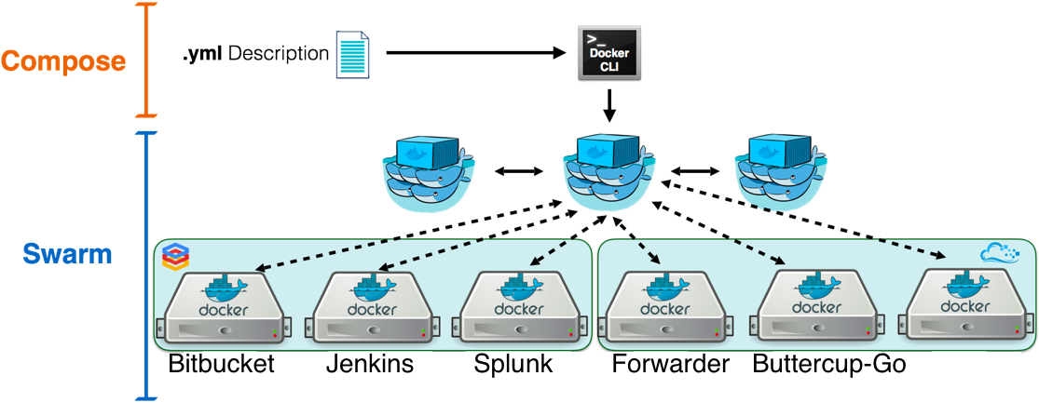
Demo Environment
Docker Test Environment
Mac OSX or Linux Versions:
Mac OSX 10.11 or Higher
CentOS 6x or 7x
Ubuntu 14.04 or Higher
Reference Link: https://store.docker.com/editions/community/docker-ce-desktop-mac

Slide 11
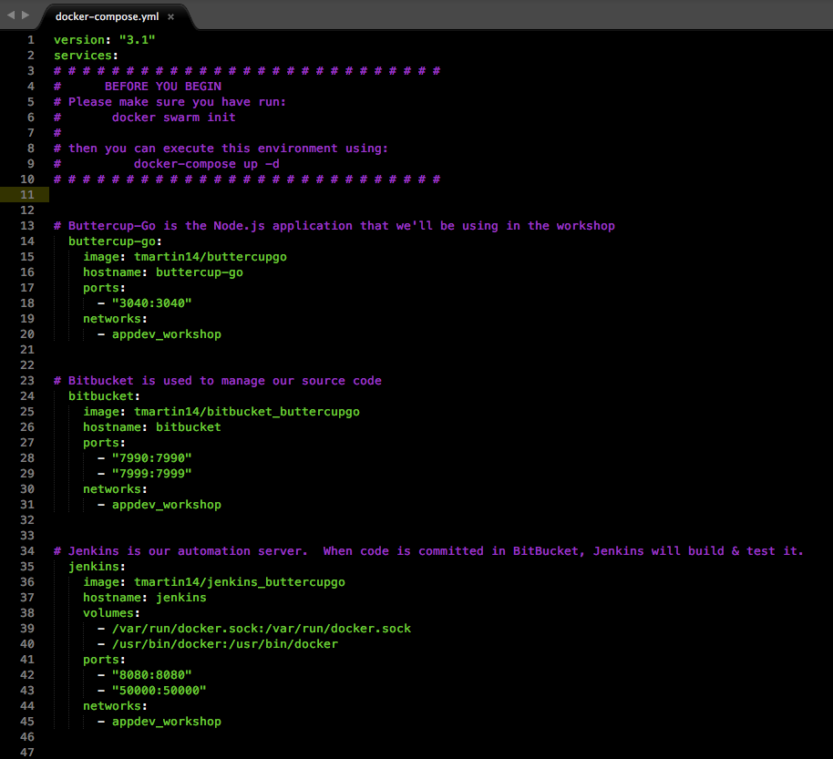
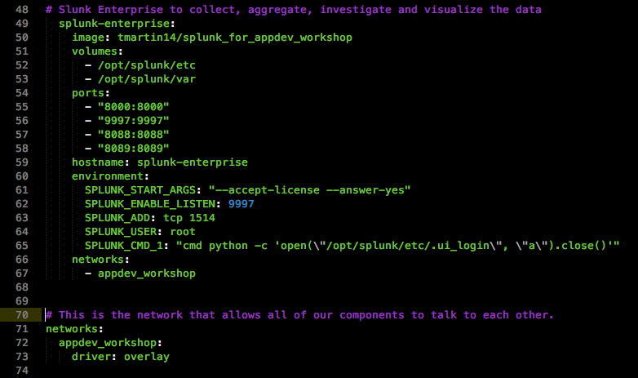
Docker-ized!

Slide 12
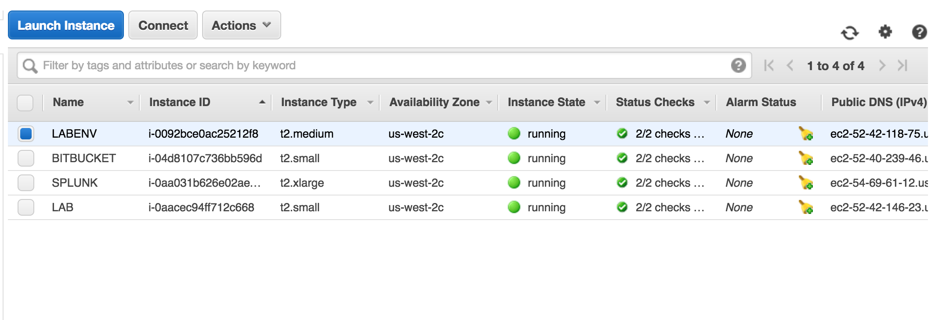
and it all runs in AWS
Your code lives here
NGINX, Node.js

Slide 13
Modern App Dev Tools
What will we be using today?

Slide 14
Bitbucket (Source Code Management)
Bitbucket (or GitHub) enables:
Simultaneous development for a single project
Different developers code different features
Tracking of Changes in Near-Realtime
Merge & Conflict Management
Issue Tracking and Jira Integrations
Automation with API's

Slide 15
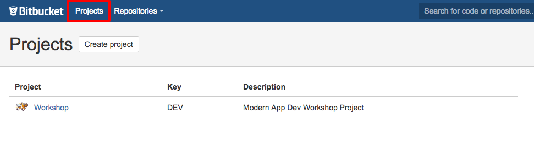
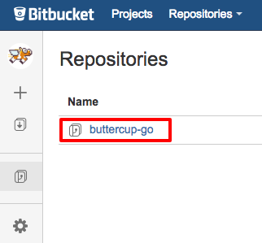
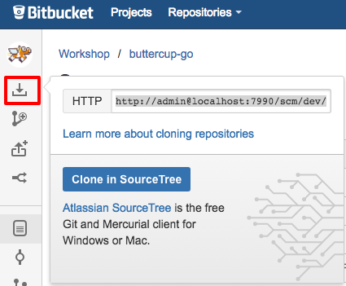
Source Code Management (Bitbucket/GitHub)
We’ll work on 1 Project
Your project has 1 repo
‘Git Clone’ your repo

Slide 16
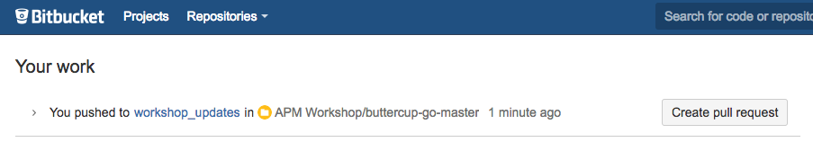
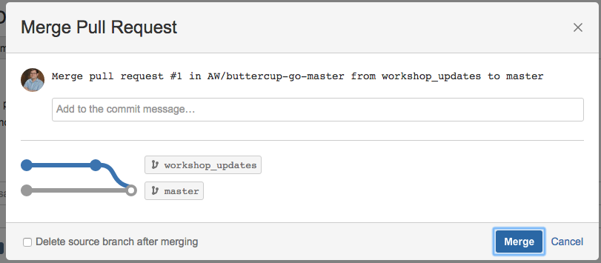
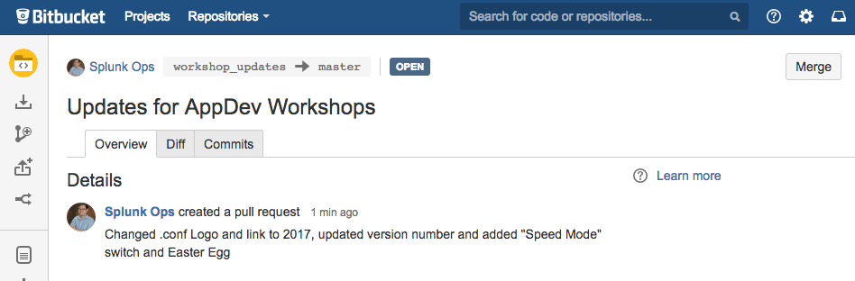
Making Changes...There's a Process
git branch module1
git checkout module1 git status ==> Are you working with module1?
git status
git add *
git commit –m "your comments here"
git push origin module1
Command Line
Create a new "branch"
Switch context to your new branch
Modify the code
Verify the changes you made
Add your changes to the be submitted
Commit your changes
Push your changes to Bit Bucket
Bitbucket UI
Create Pull Request
Merge

Slide 17
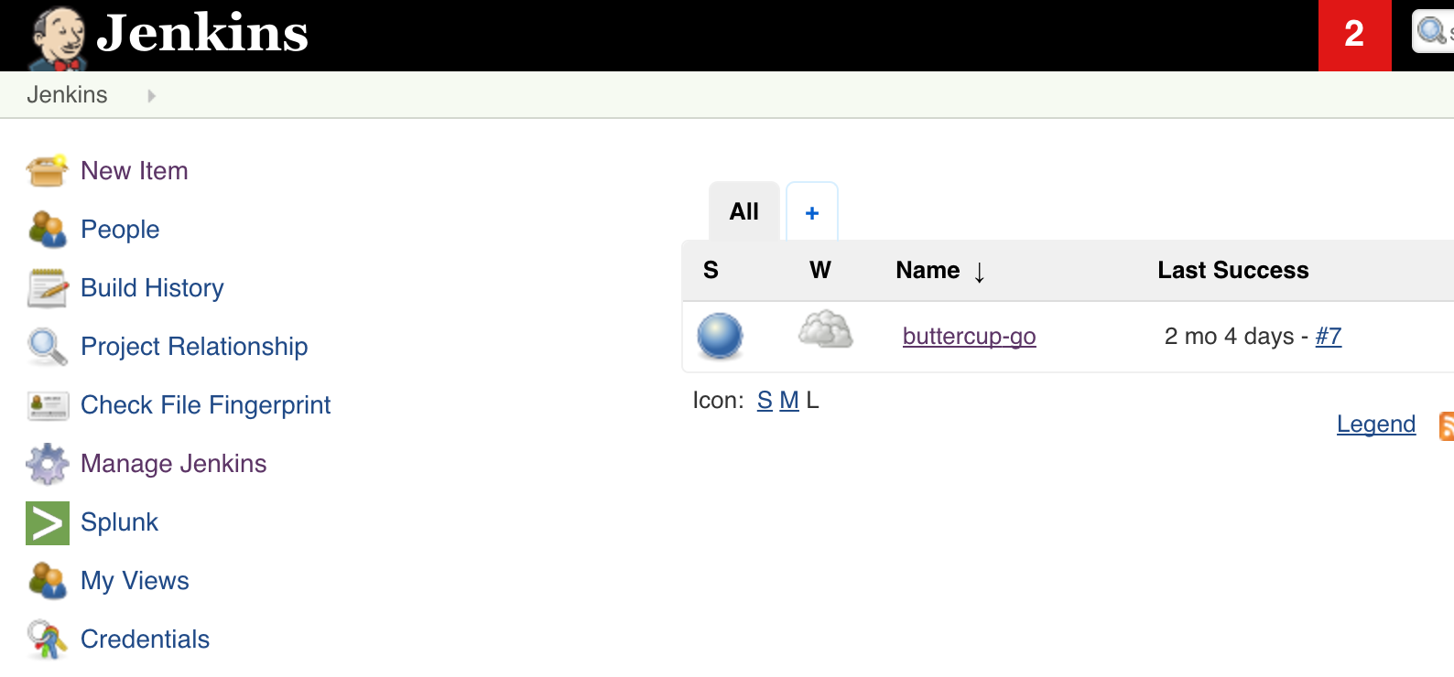
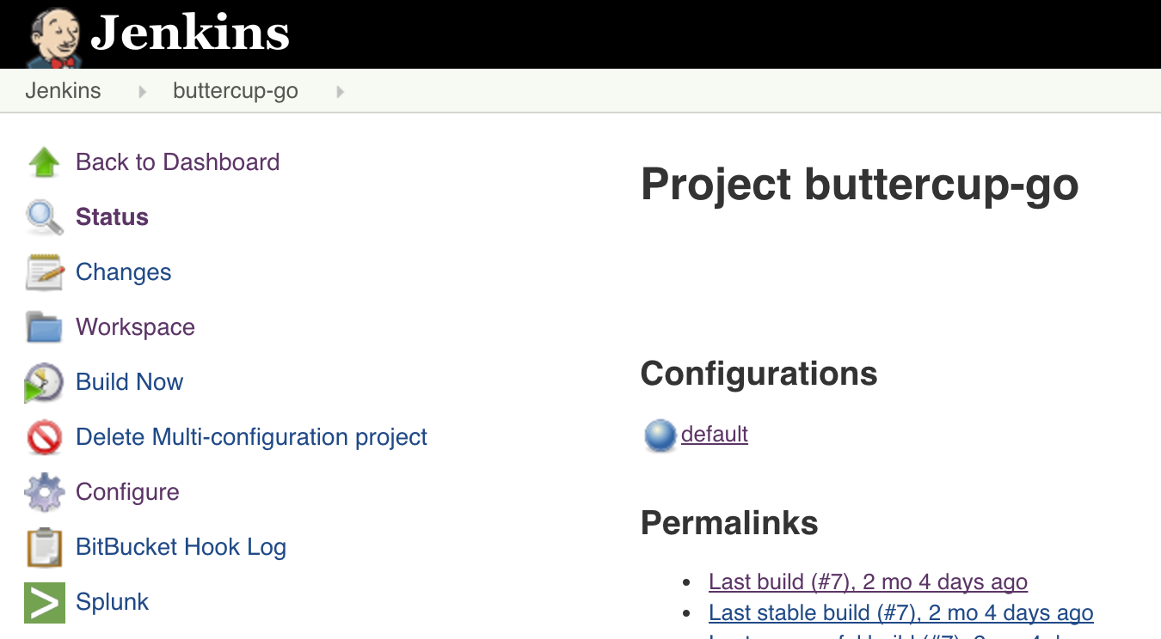
Automated Deployment - CI/CD using Jenkins
1 Build Plan per Student
1 Branch per Build Plan
Jenkins will automatically build your project and deploy it when you merge your code
Build Plan
npm install npm install newrelic npm build npm start

Slide 18
Authentication
Using Auth0 to track users and device information

Slide 19

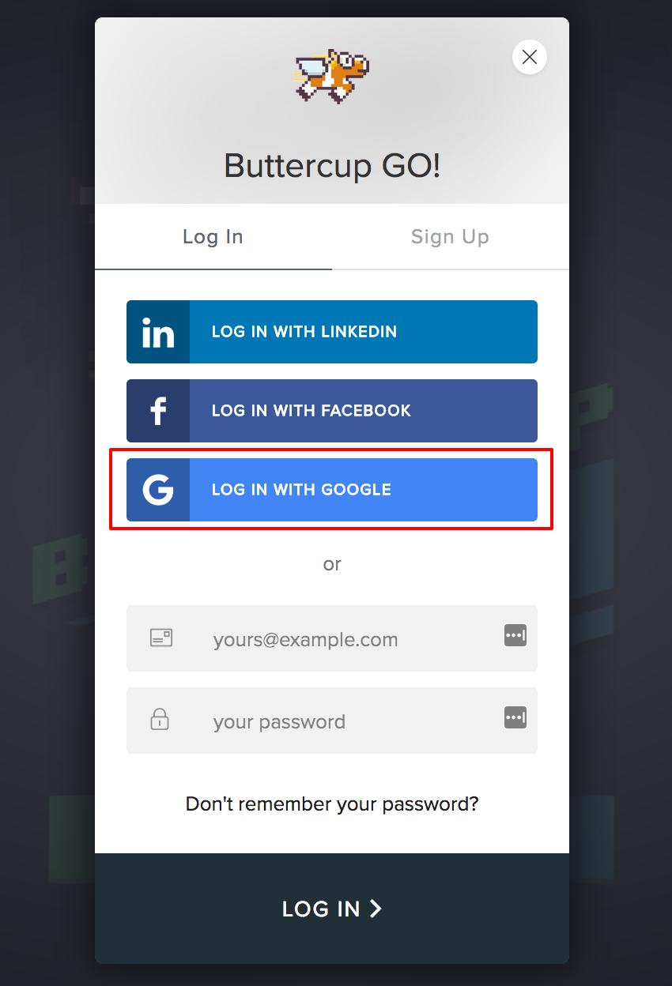
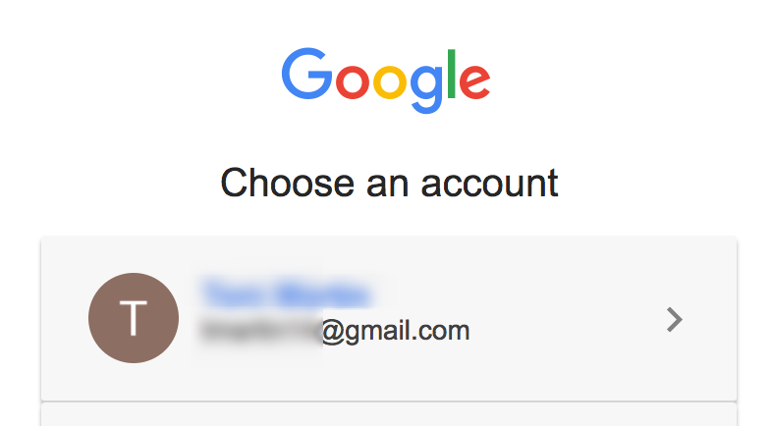
How it works from the user’s perspective

Slide 20
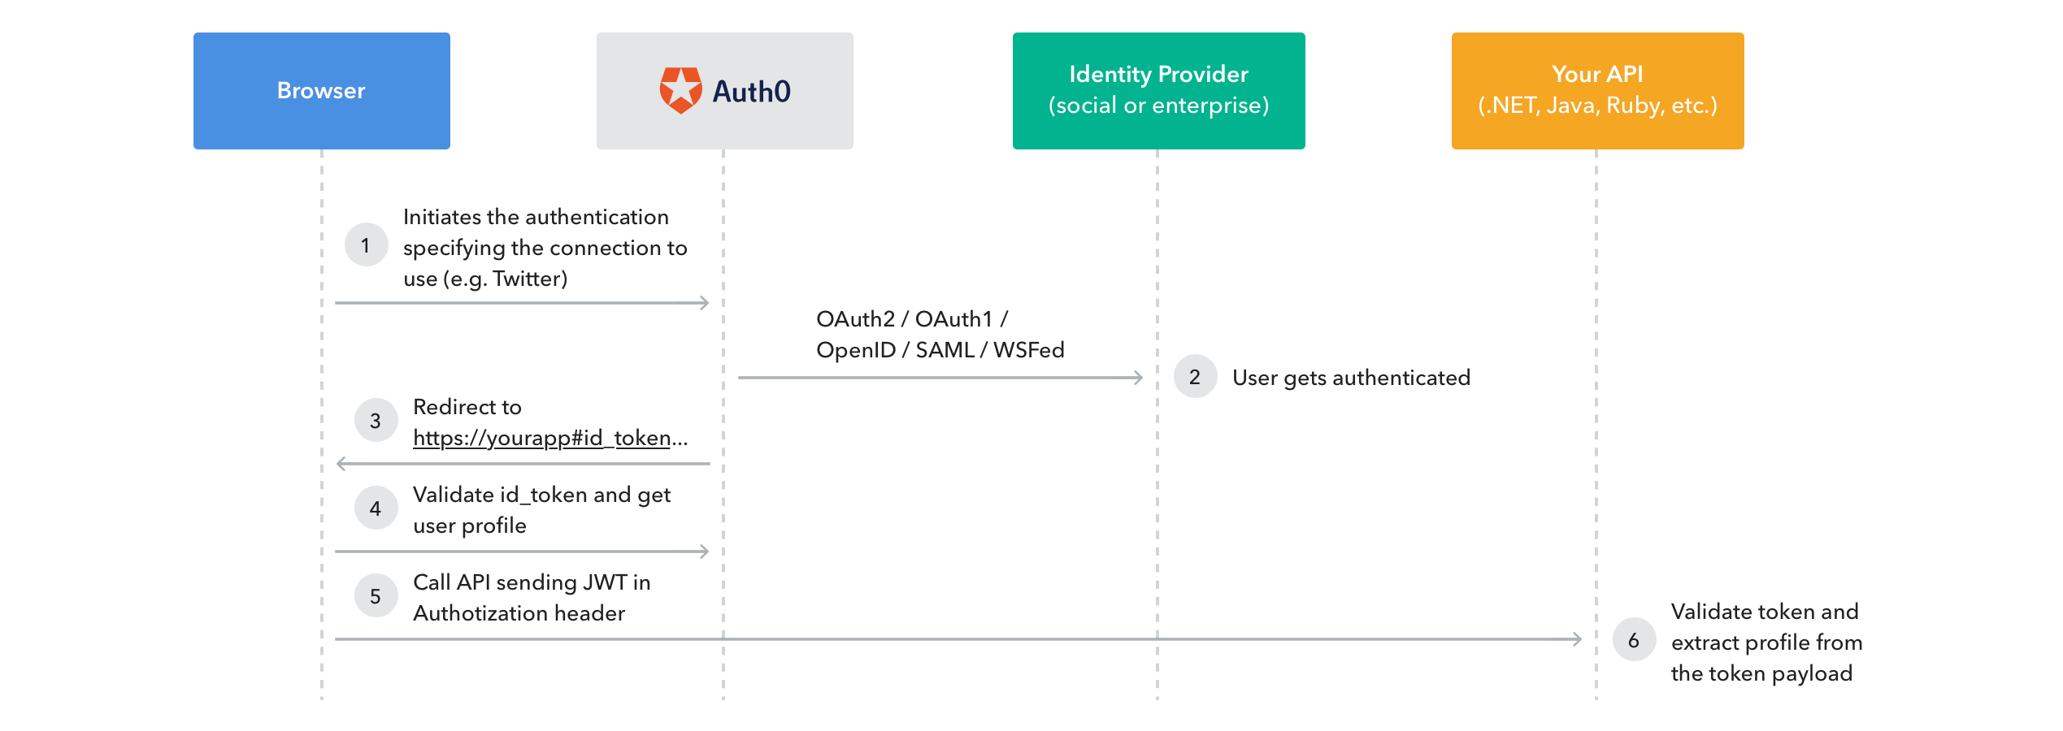
How Auth0 really works

Slide 21
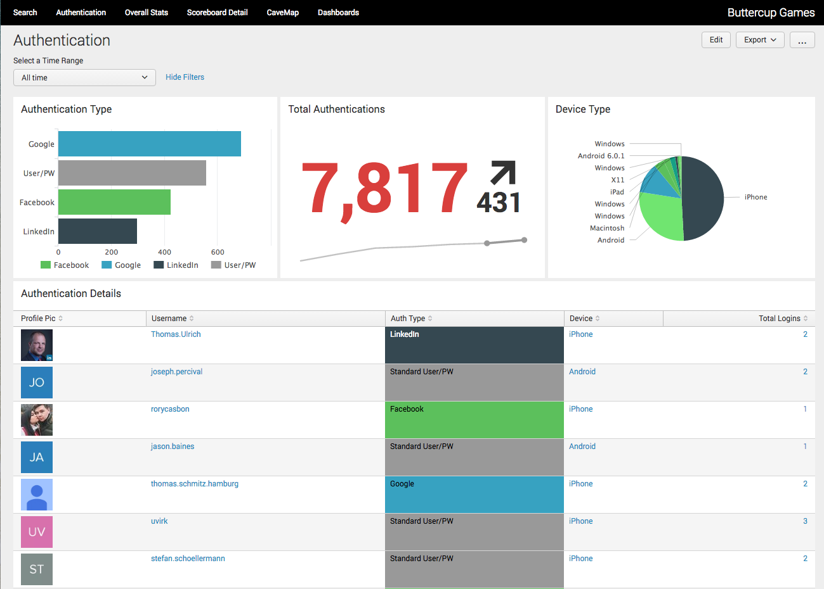
What can I see in Splunk?
User Behaviors
Number of logins
Authentications by source
Errors for a given user
Platforms
Trends

Slide 22
Data Gathering
Splunking Application Data too!

Slide 23
Splunk HTTP Event Collector (HEC)
A highly scalable endpoint to send data into Splunk over http(s)
Settings → Data Input → HTTP Event Collector
curl -k https://<host>:8088/services/collector \ -H 'Authorization: Splunk <token>' \ -d '{"sourcetype": "mysourcetype", "event":"Hello, World!"}'

Slide 24
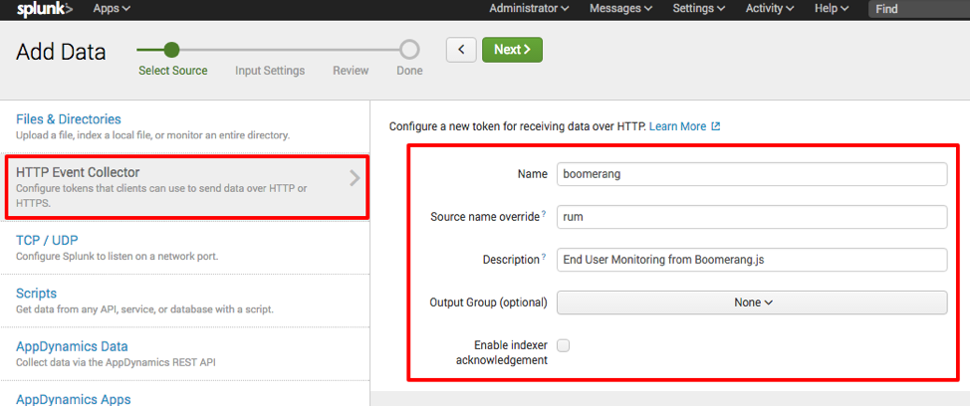
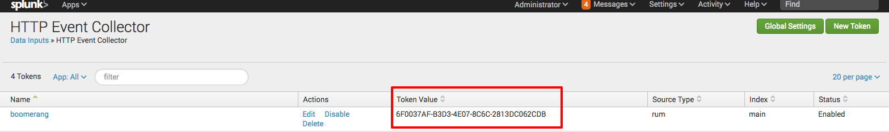
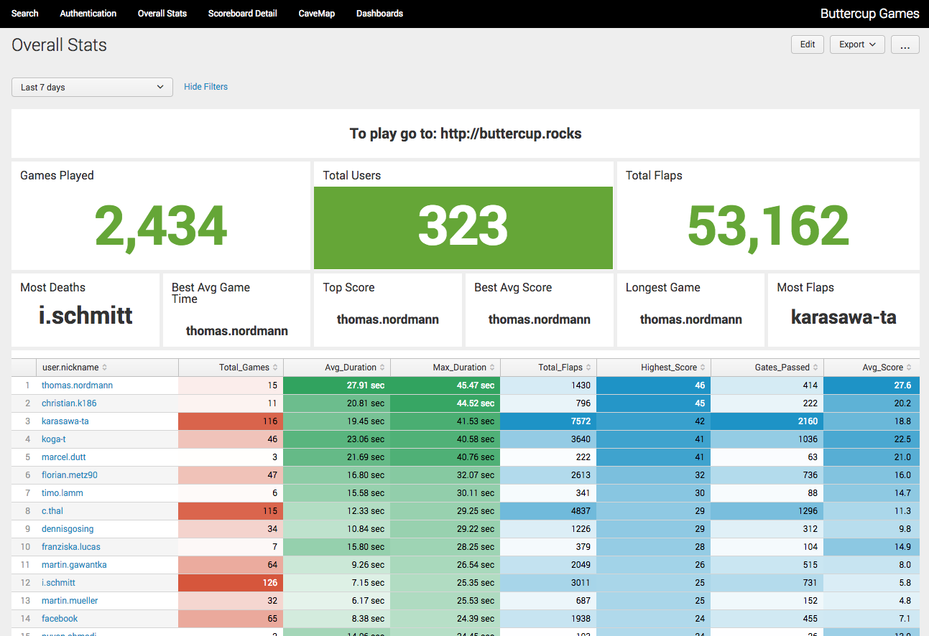
Capture Business Metrics from the App via HEC
Create HEC Token
Install Splunk Logging npm install --save splunk-logging
Add logging code
Monitor your app
var SplunkLogger = require("splunk-logging").Logger;
var config = {
token: "your-token-here",
url: "https://splunk.local:8088"};
var Logger = new SplunkLogger(config);
var payload = {
message: {
temperature: "70F",
chickenCount: 500
}
};
Logger.send(payload, function(err, resp, body) {
// If successful, body will be { text: 'Success', code: 0 }
console.log("Response from Splunk", body);
});

Slide 25
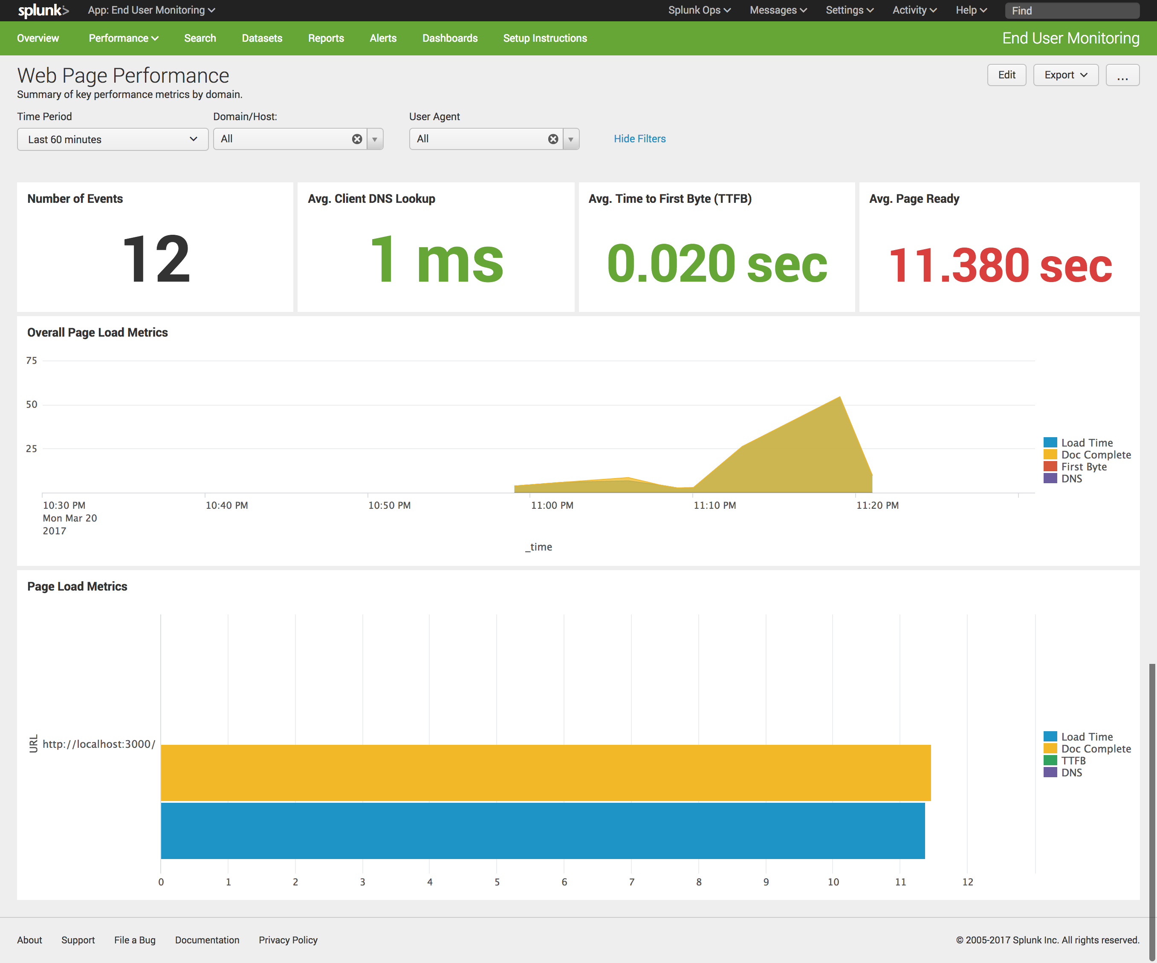
End User Experience - Boomerang.js & HEC
Create HEC Token
Add JavaScript to your page
Monitor Real Users
<!-- Boomerang.js Browser Code -->
<script src="https://s3.amazonaws.com/boomerang-splunk/boomerang.js"></script>
<script src="https://s3.amazonaws.com/boomerang-splunk/plugins/rt.js"></script>
<script>
BOOMR.init({ beacon_url: "http://<Splunk Server>:8088/services/collector/raw?channel=<HEC Token>",
beacon_type: "POST",
beacon_auth_token: "Splunk <HEC Token>",
site_domain: "What's up Buttercup?"
});
BOOMR.addVar({ "ua_raw" : navigator.userAgent ,
"appName" : "Buttercup-Go-Student-" });
</script>
<!-- END Boomerang.js Browser Code -->

Slide 26
End User Experience - Mint.js
Add Mint.js to your app (mint.min.js) [ /app/utils/splunkhttp.js ]
Initialize Mint.js & start sending data!
Monitor Real Users
// Adding Mint.js
const mint = require('assets/scripts/mint/mint.min.js');
// Initialize Mint.js
Mint.initAndStartSession({ apiKey: ’abcdefgh', collectLogs: true, collectNetworkCalls: false });
Mint.setPackageName('Buttercup-Go');
…
// Send data to Miint!
Mint.setUserIdentifier(’abc123');
Mint.logEvent('Buttercup-Go', 'info',<JSON - whatever data you want to send>);

Slide 27
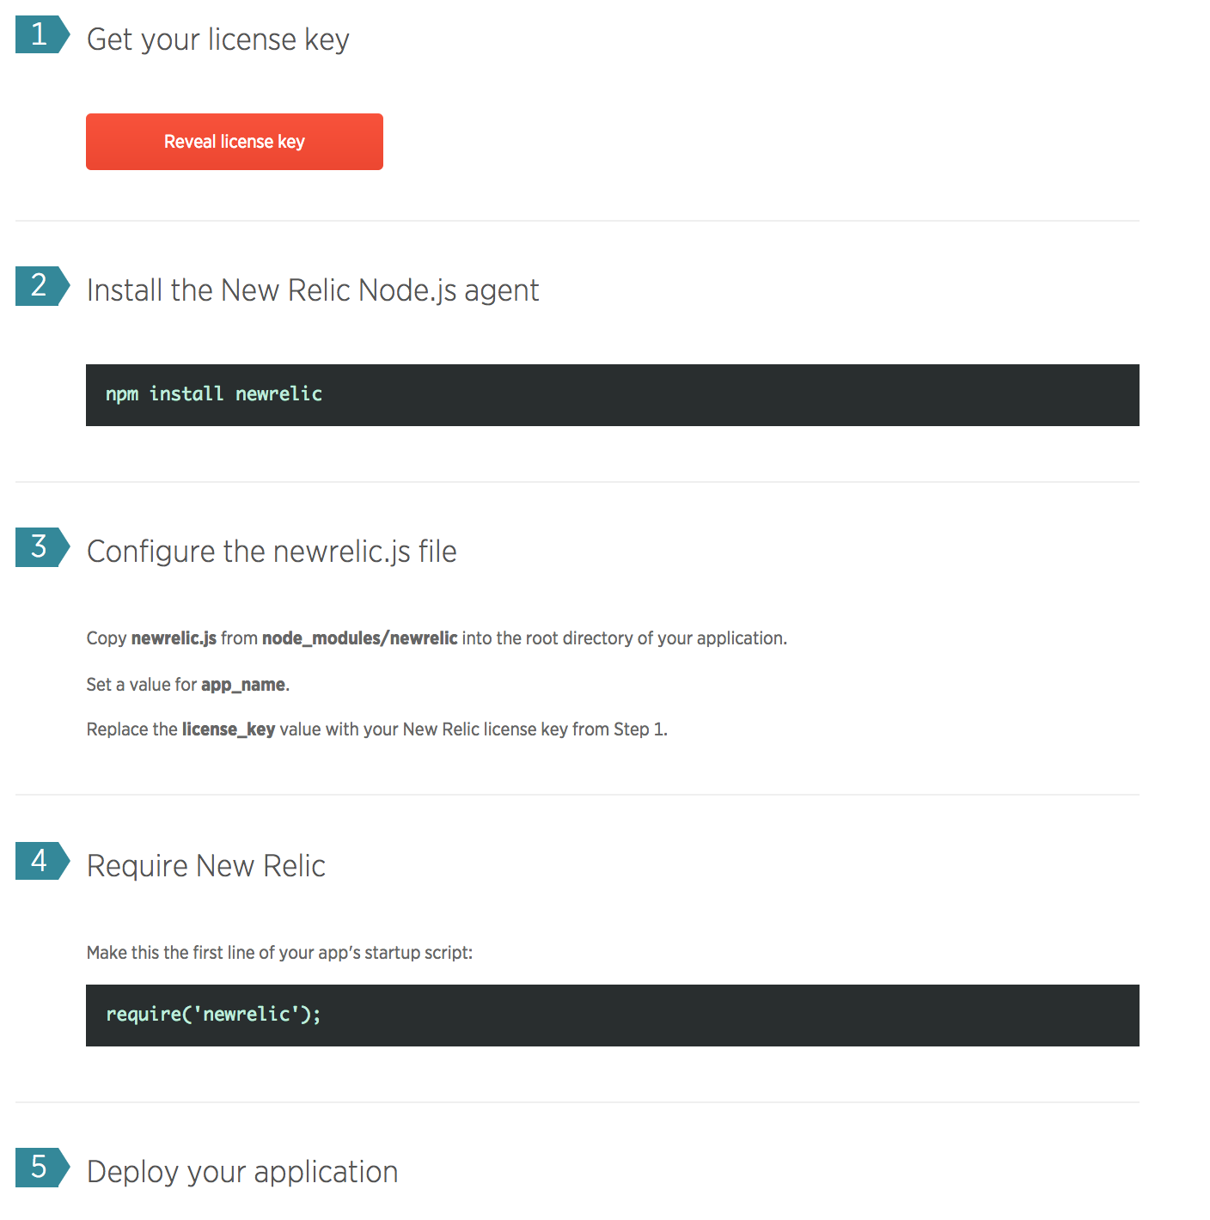
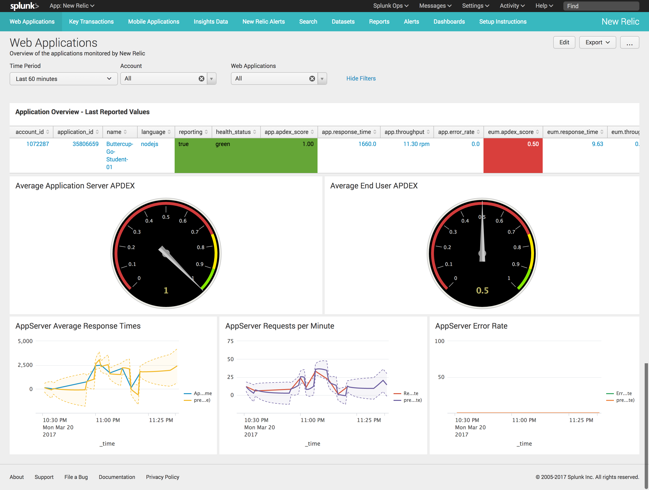
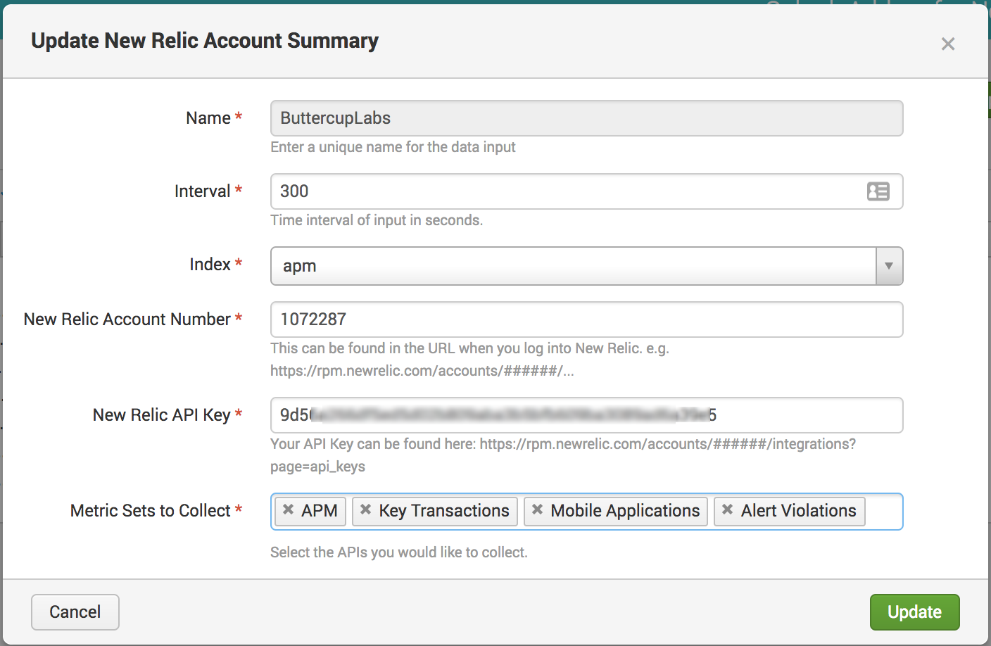
APM – New Relic
Instrument the app
Add the Javascript
APM Add-On in Splunk
View APM Data!
<!-- NEW RELIC BROWSER CODE -->
<script src=”<your-newrelic-snippet"></script>

Slide 28
How does this all Fit Together?
Understanding the pieces…

Slide 29
Build Chain Automation
Developer
Bitbucket
Jenkins
Node.js
Commit
Build
Deploy
Metrics
Metrics
Metrics
Splunk

Slide 30
Run & Monitor
Node.js
Browser/Mobile
Static
Content
CDN
User Interactions
Application Metrics
End User Metrics
Auth
APM
Auth
Auth0
Auth0
Application Logs
End User Metrics
Metrics & Alerts
Splunk
Cache Metrics

Slide 31
DevOps + Application Monitoring
Developer
Bitbucket
Jenkins
Node.js
Browser/Mobile
CDN
Commit
Build
Deploy
User Interactions
Static
Content
Application Metrics
End User Metrics
Metrics
Metrics
Metrics
Application Logs
APM
Metrics & Alerts
AWS
Splunk
End User Metrics
Cache Metrics

Slide 32
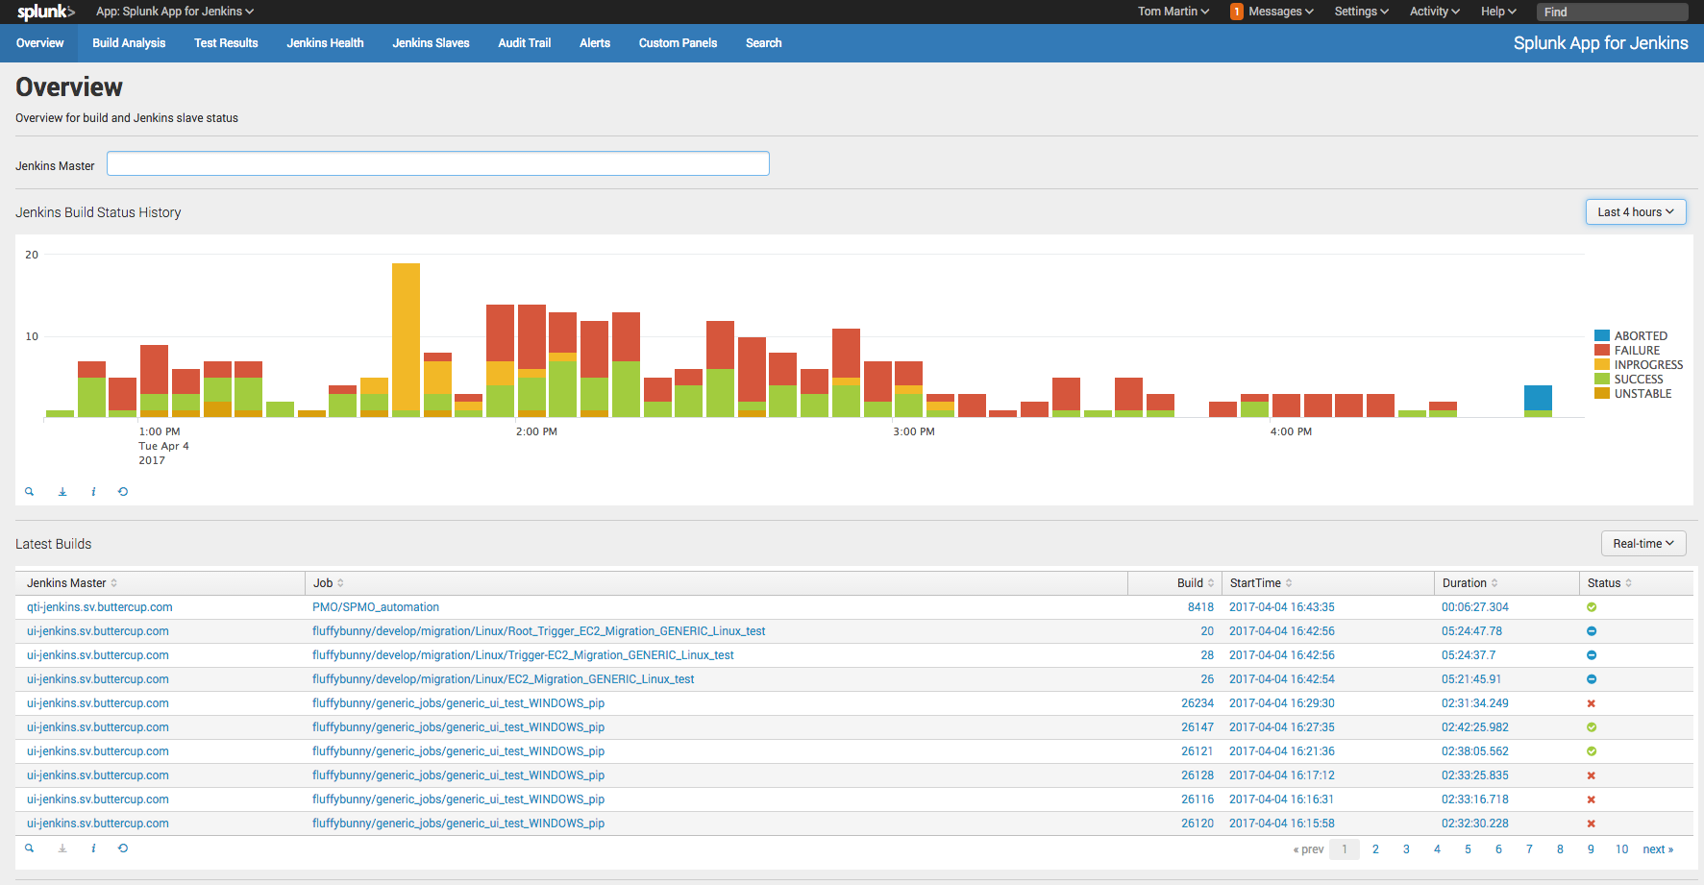
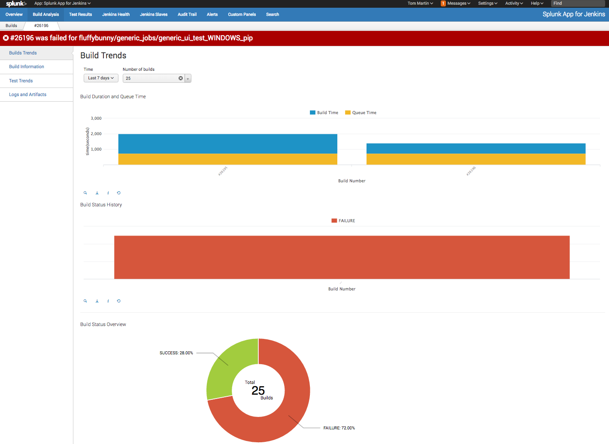
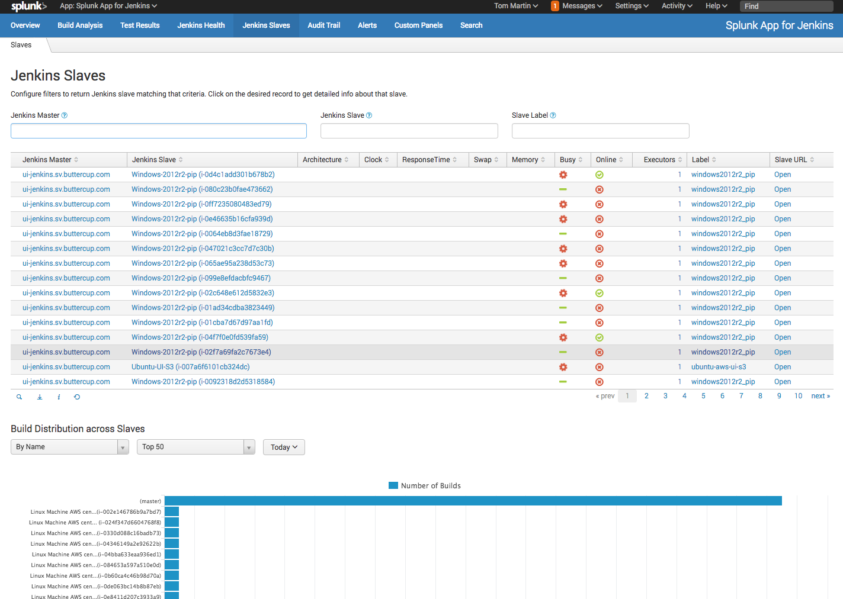
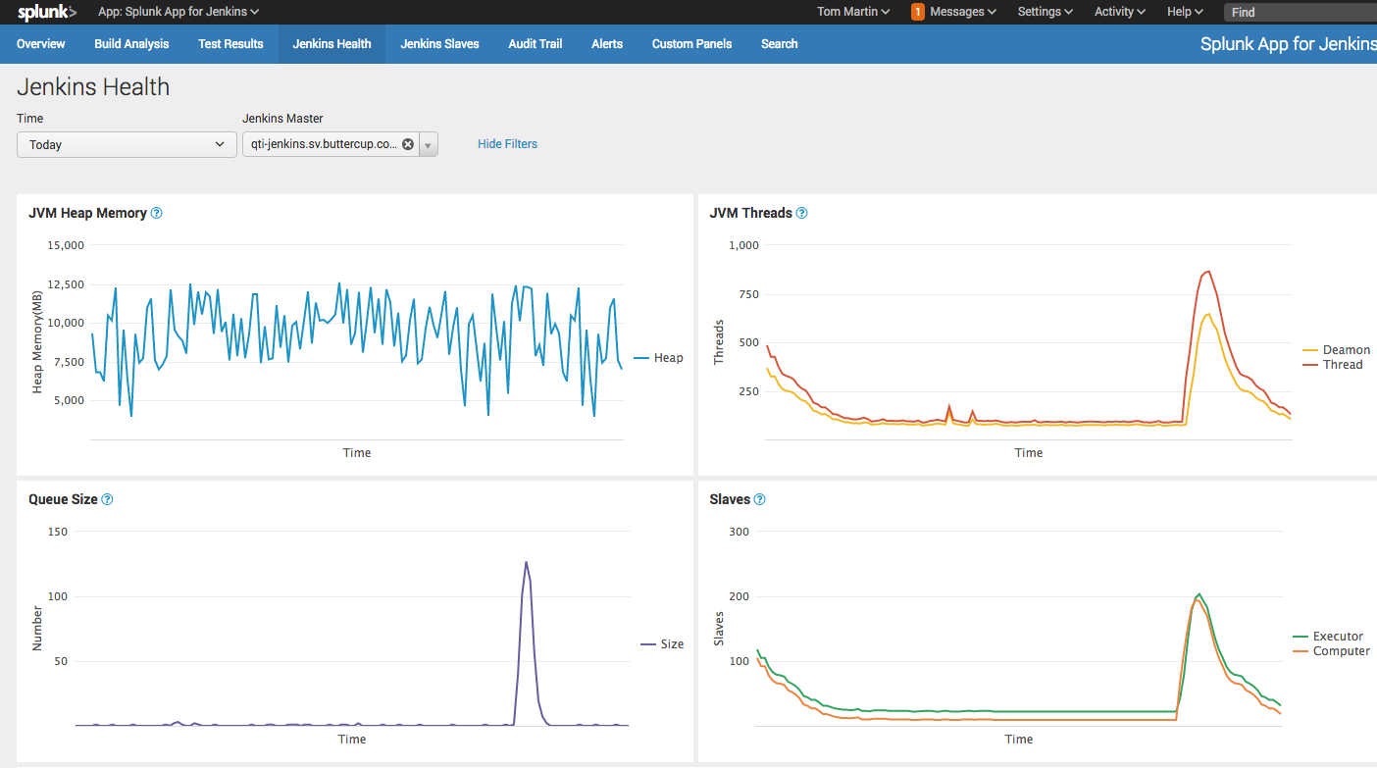
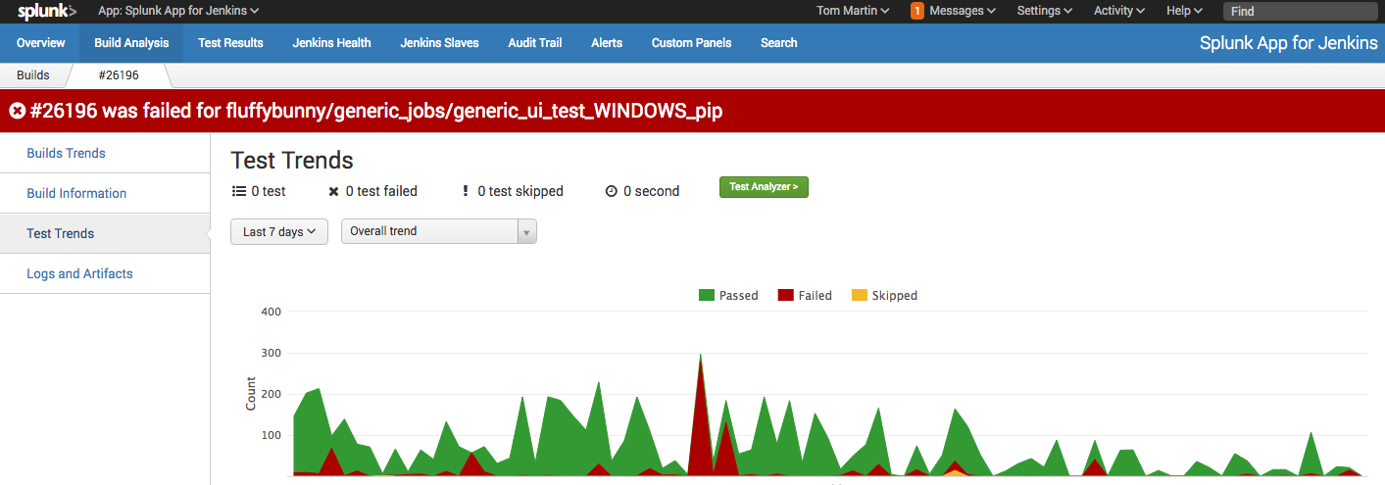
Bringing It Together for DevOps

Slide 33
Bringing It Together for Business & Users

Slide 34
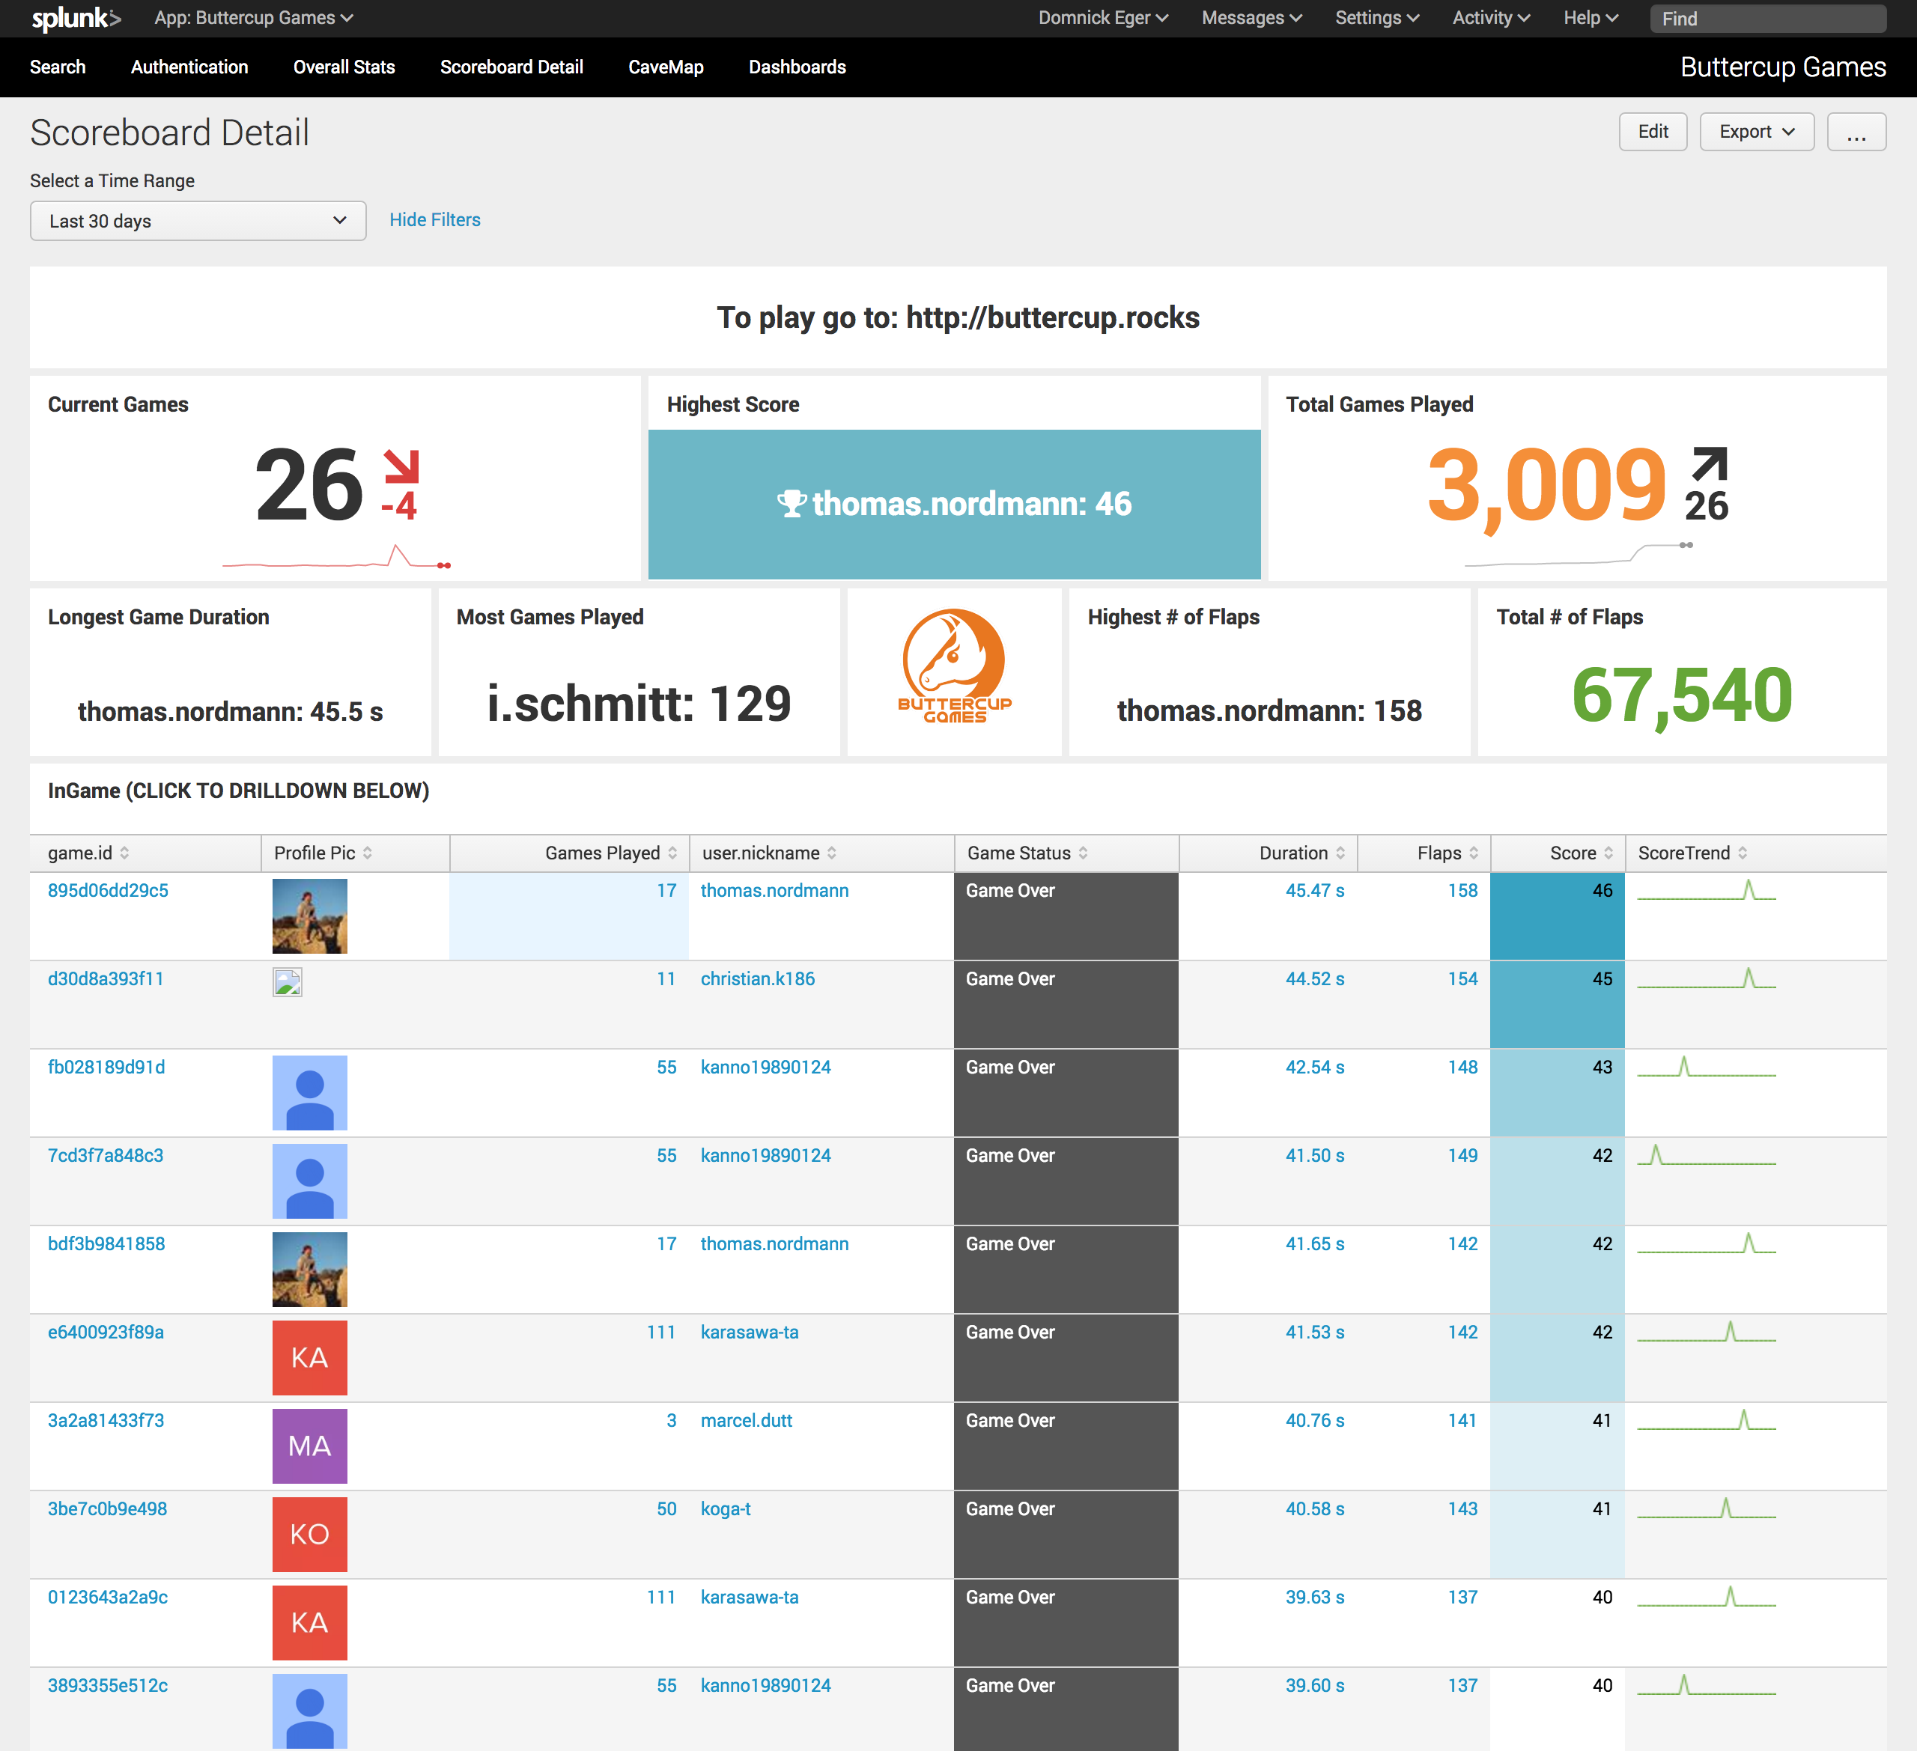
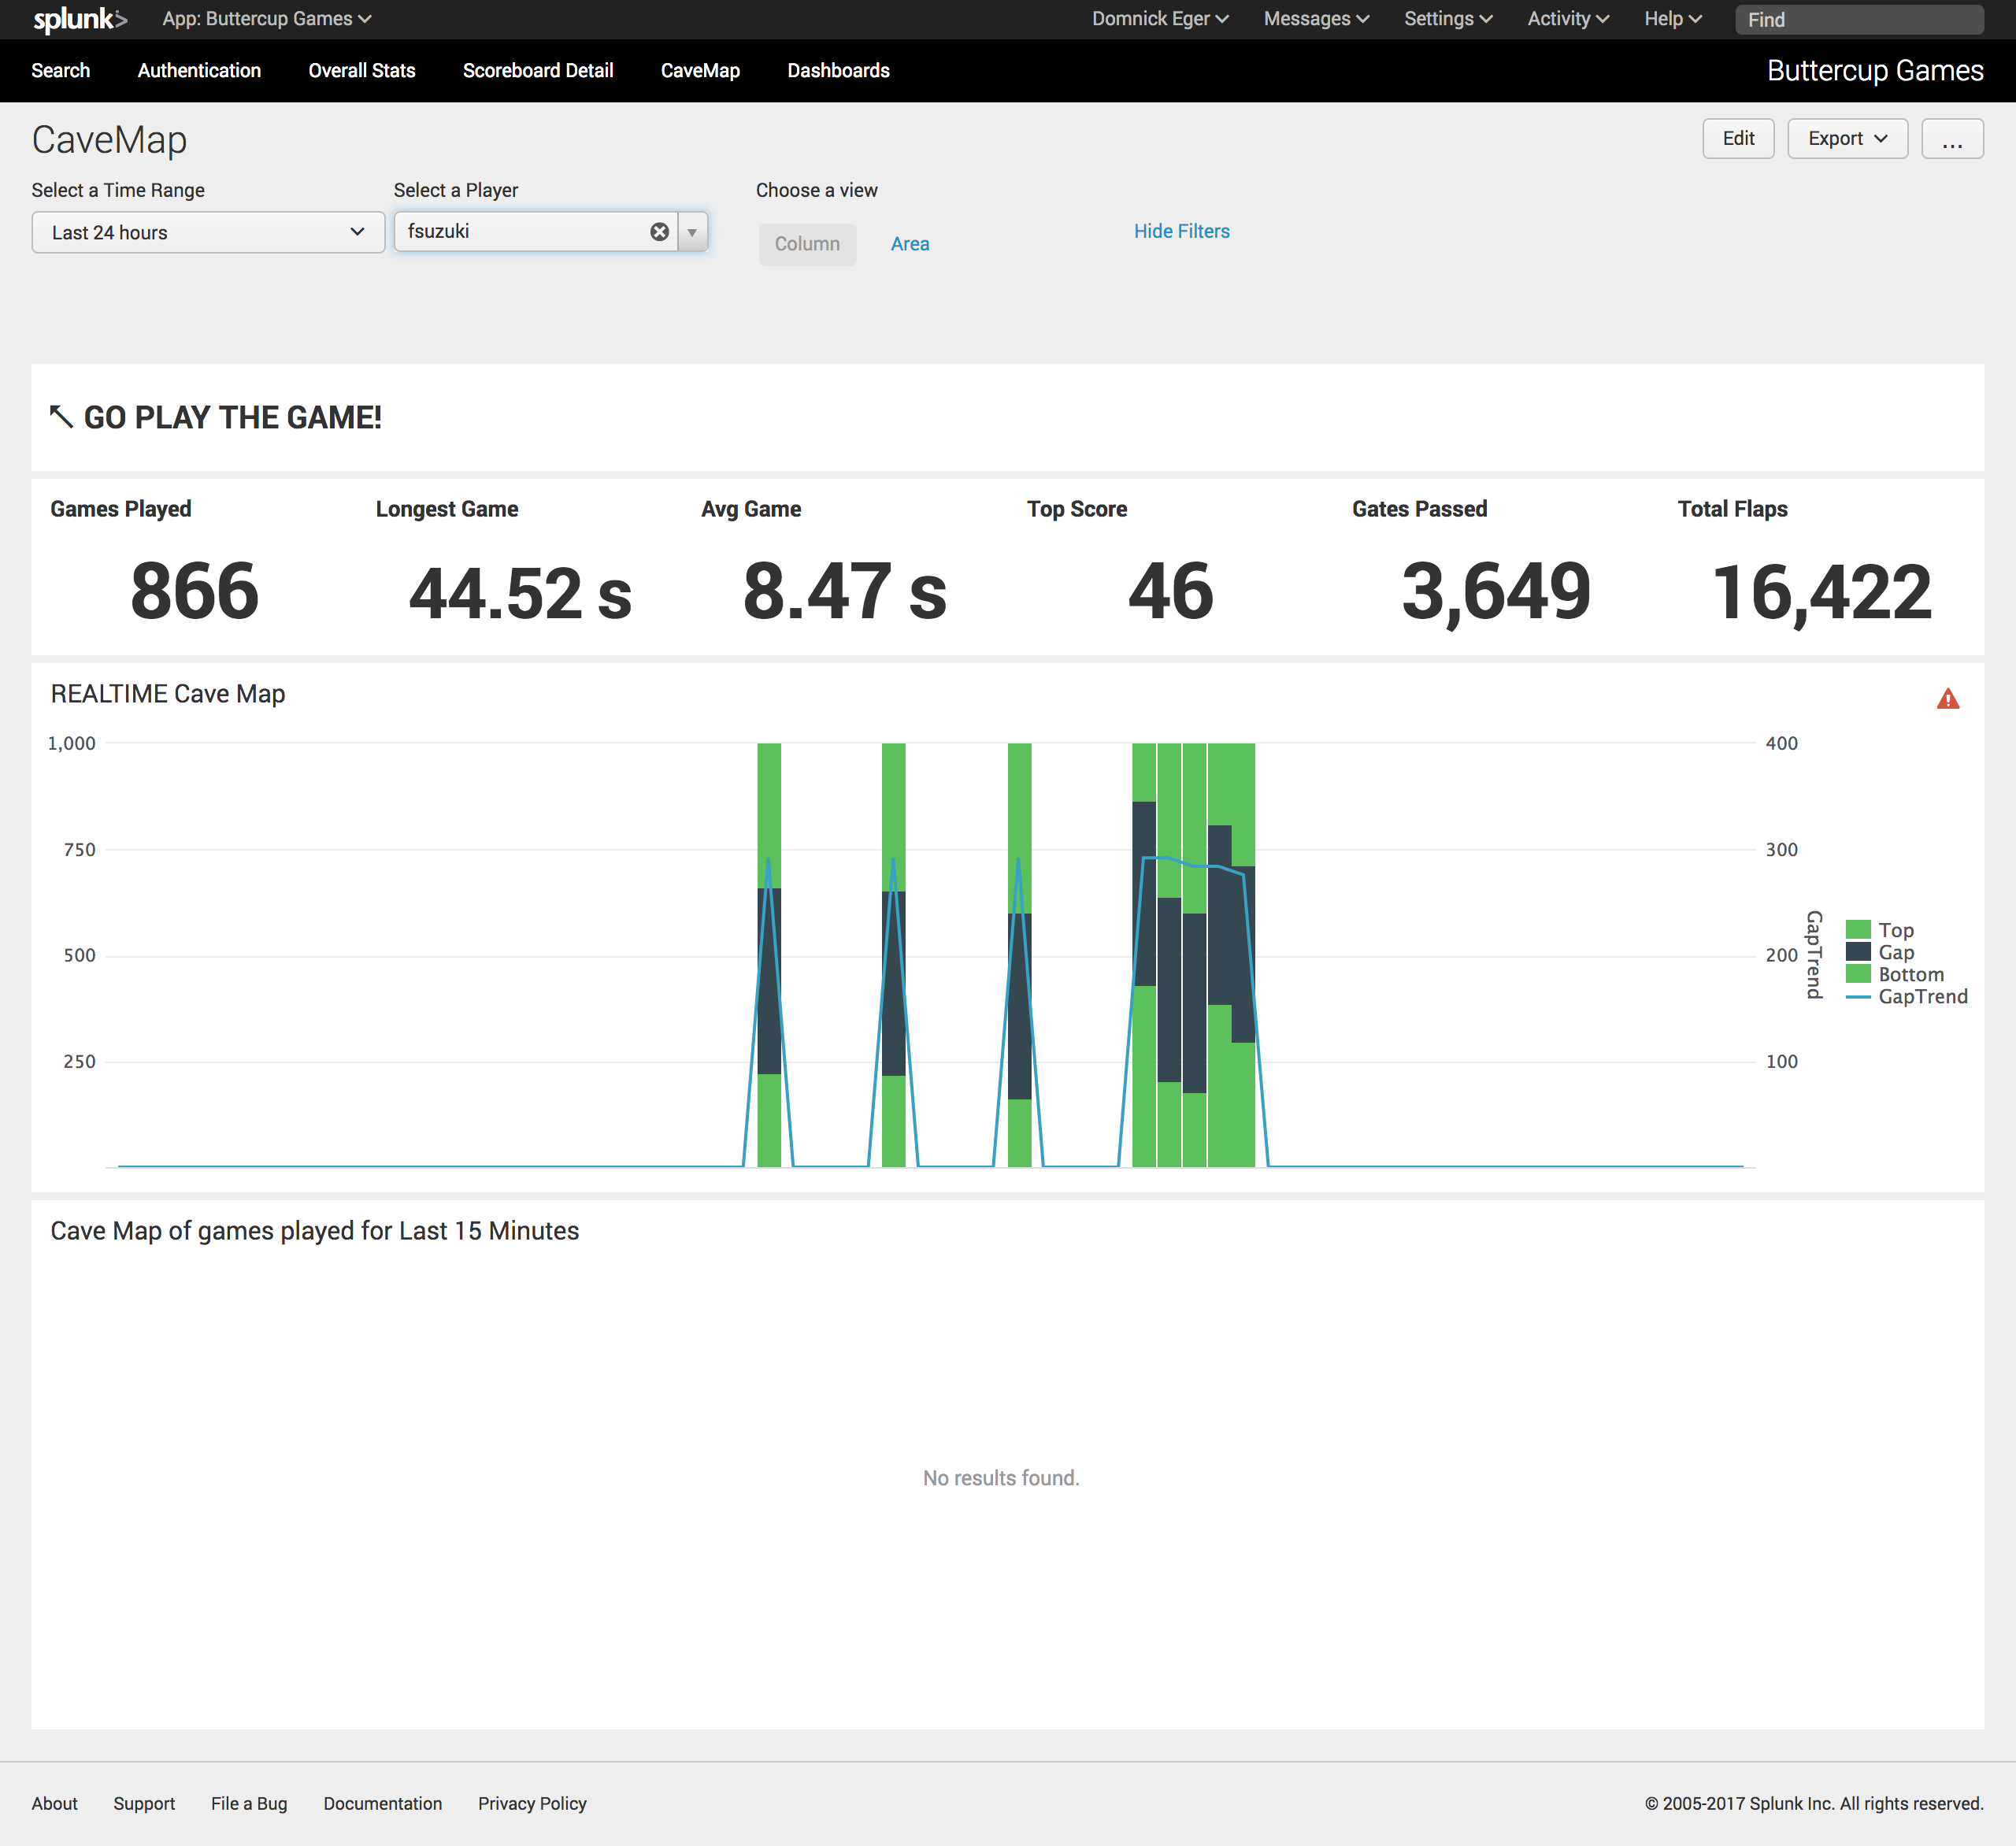
Realtime Gaming Metrics

Slide 35
Let’s Get Started Already…

Slide 36
Break!
Be back in 10 minutes

Slide 37

Ready for some Fun ?
Let get our hands on the keyboards!

Slide 38
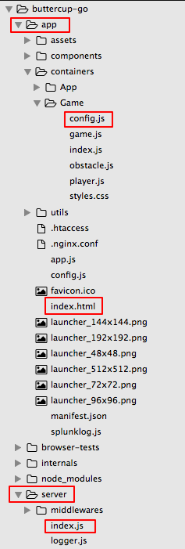
Node.js – Server and Client
/app:
Everything running in the browser
config.js - Global game settings (speed, gravity, etc.)
index.html - where we’ll add EUEM code
/server:
Serving the app on port 3040
index.js - where we’ll add a New Relic APM agent

Slide 39
Module 1: Installation & Startup
System Requirements:
Hardware: 16GB RAM & processor to match (multiple docker images)
OSX, Linux, or Virtual Box on Windows
Git Installed via Homebrew, or Cygwin or Virtual Box with Linux
Docker installed
Download workshop materials
Install & configure Git
Install Docker
Start the Docker Swarm (a.k.a. cluster)

Slide 40
Module 2: Environment Verification
For ALL Logins: Username: admin Password: changeme
Verify Buttercup-Go: http://localhost:3040
Verify Splunk Login: http://localhost:8000
Verify Bitbucket Login: http://localhost:7990
Verify Jenkins Login: http://localhost:8080
Examine the ‘default’ build plan in Jenkins
Git clone the Buttercup-Go repo into your \workshop directory: cd workshop git clone http://admin@localhost:7990/scm/dev/buttercup-go.git

Slide 41
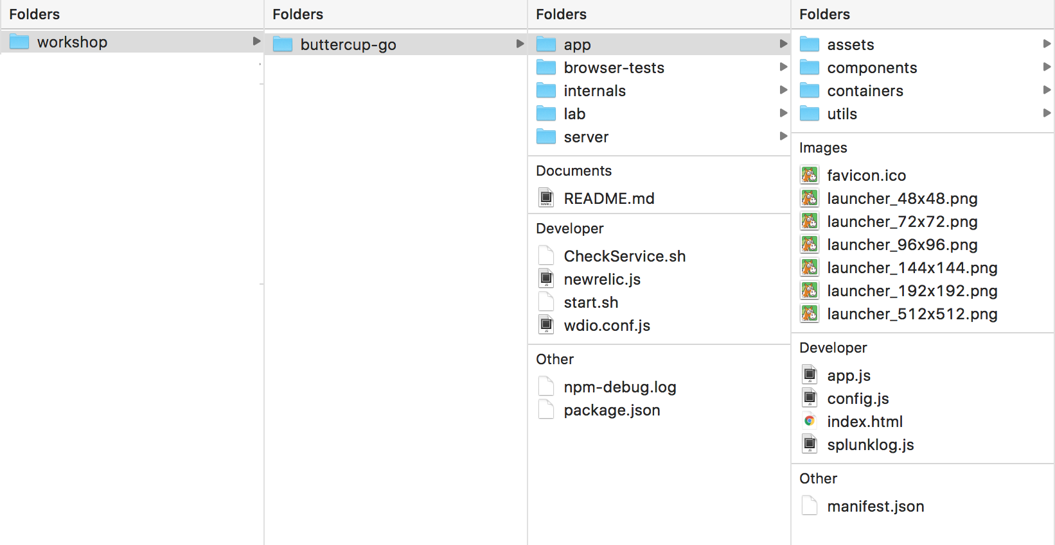
Your local file system

Slide 42
Module 3: Modifying the Game Images
Create a Git branch for the images modifications
Make a backup of the original images
Move the new images into the application
Git Add, Commit & Push your changes then create a Pull request
Goto Jenkins build page for your build and validate the plan was successful
Test your changes by going to https://localhost:3040/
Verify images have changed (are you seeing gray?)

Slide 43

Before and After…

Slide 44
Module 4: Adding End User Monitoring with Boomerang.js & HEC
Create a Git branch for the changes
Add Boomerang.js to your Buttercup-Go application
Find your HEC Token in Splunk (Settings→Data Inputs→ HEC)
Push your changes into the branch build. Test configuration by forcing Jenkins to kick off a build.
Test your changes by going to http://localhost:3040
Verify by logging into splunk and looking at the End User Monitoring App http://localhost:8000/en-US/app/splunk_app_End_User_Monitoring/real_time_performance

Slide 45
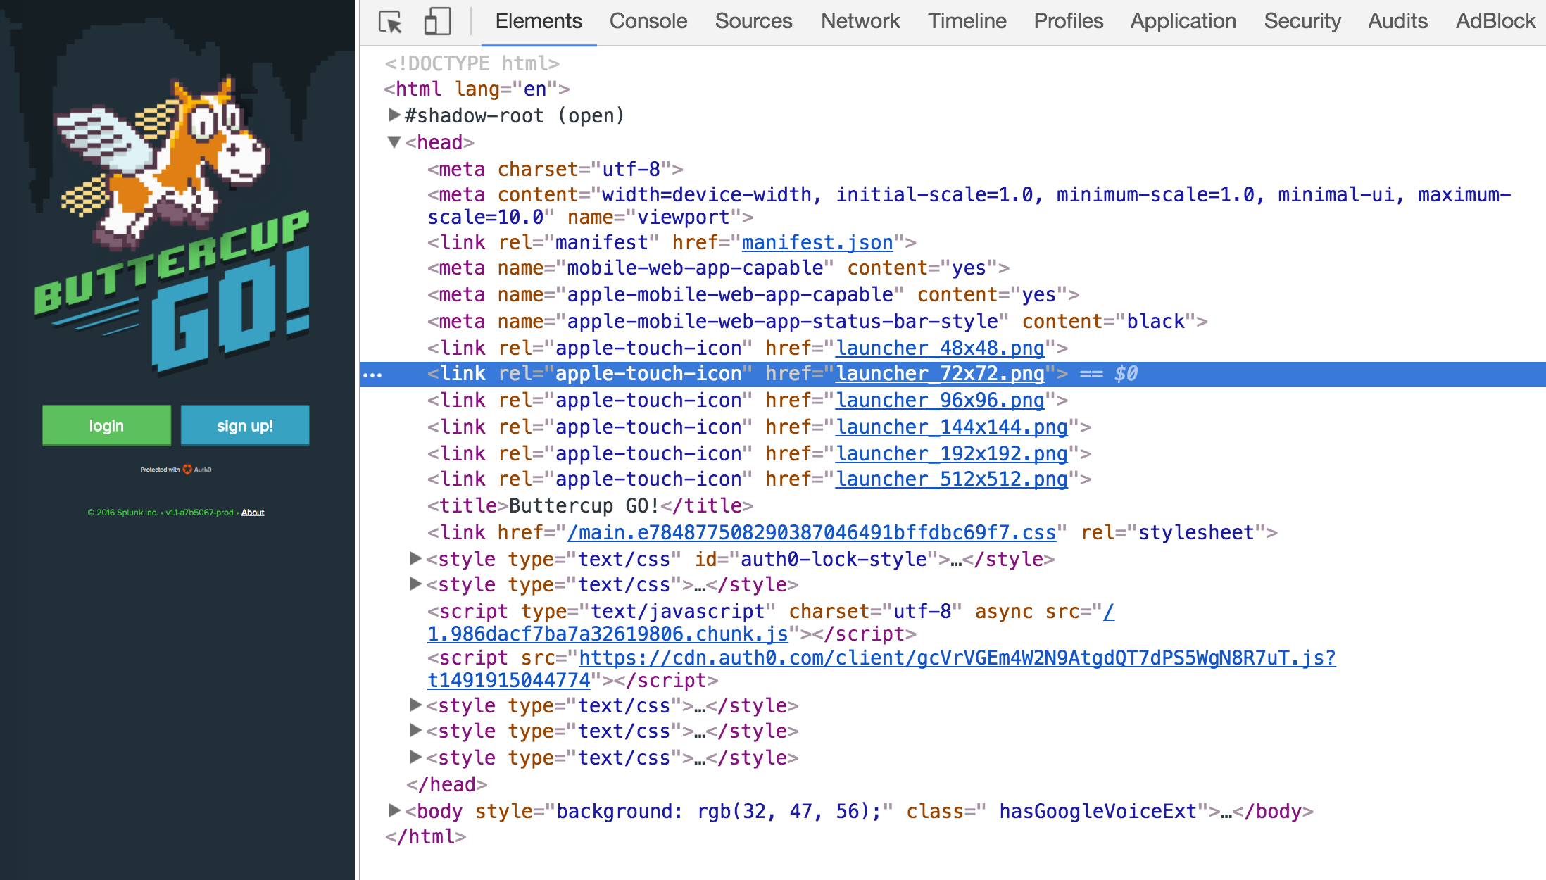
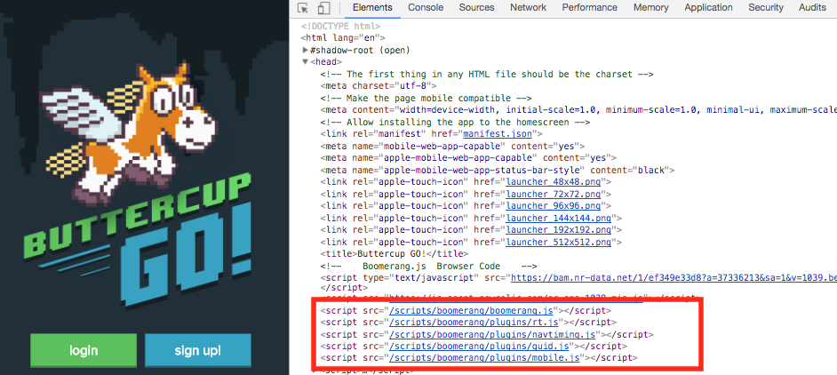
Before and After…

Slide 46

Module 5: HEC in High Volume Environments
The Splunk HTTP Event Collector is designed to handle high volume traffic.
HEC can handle millions of requests per second!
In this module we will use a hidden feature of the Buttercup-Go game to insert many logging events via the HEC REST endpoint.
Reload your game and click the 'About' link in the footer
Click the button for
When you return back to your game, you’ll be in ’SuperSpeed’ mode.
Give it a try and see how many events are being pushed to Splunk via HEC

Slide 47
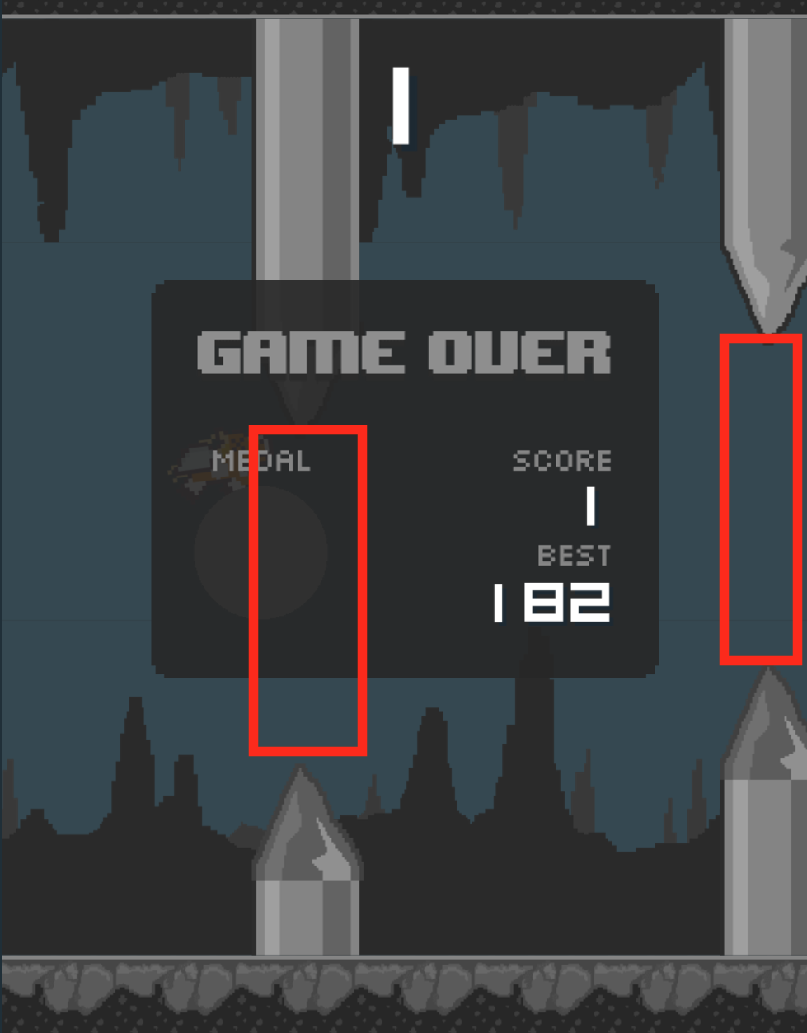
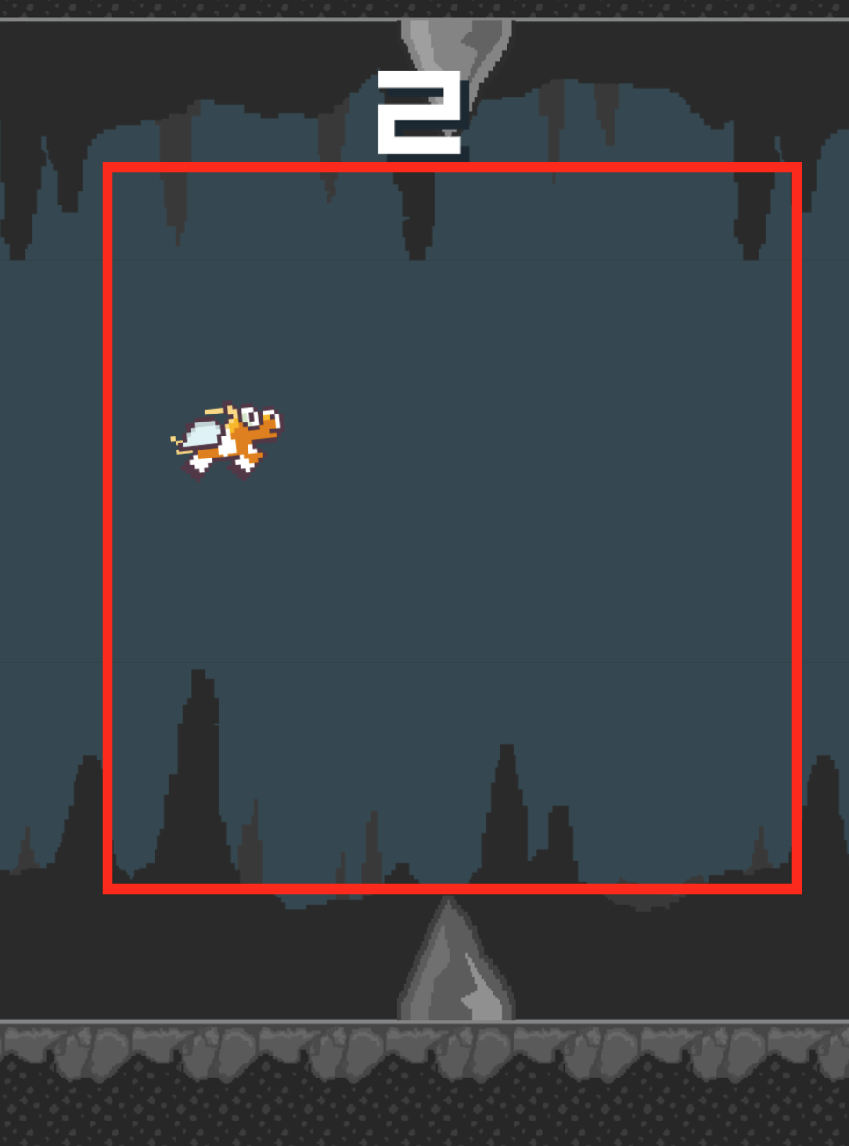
Before and After…

Slide 48
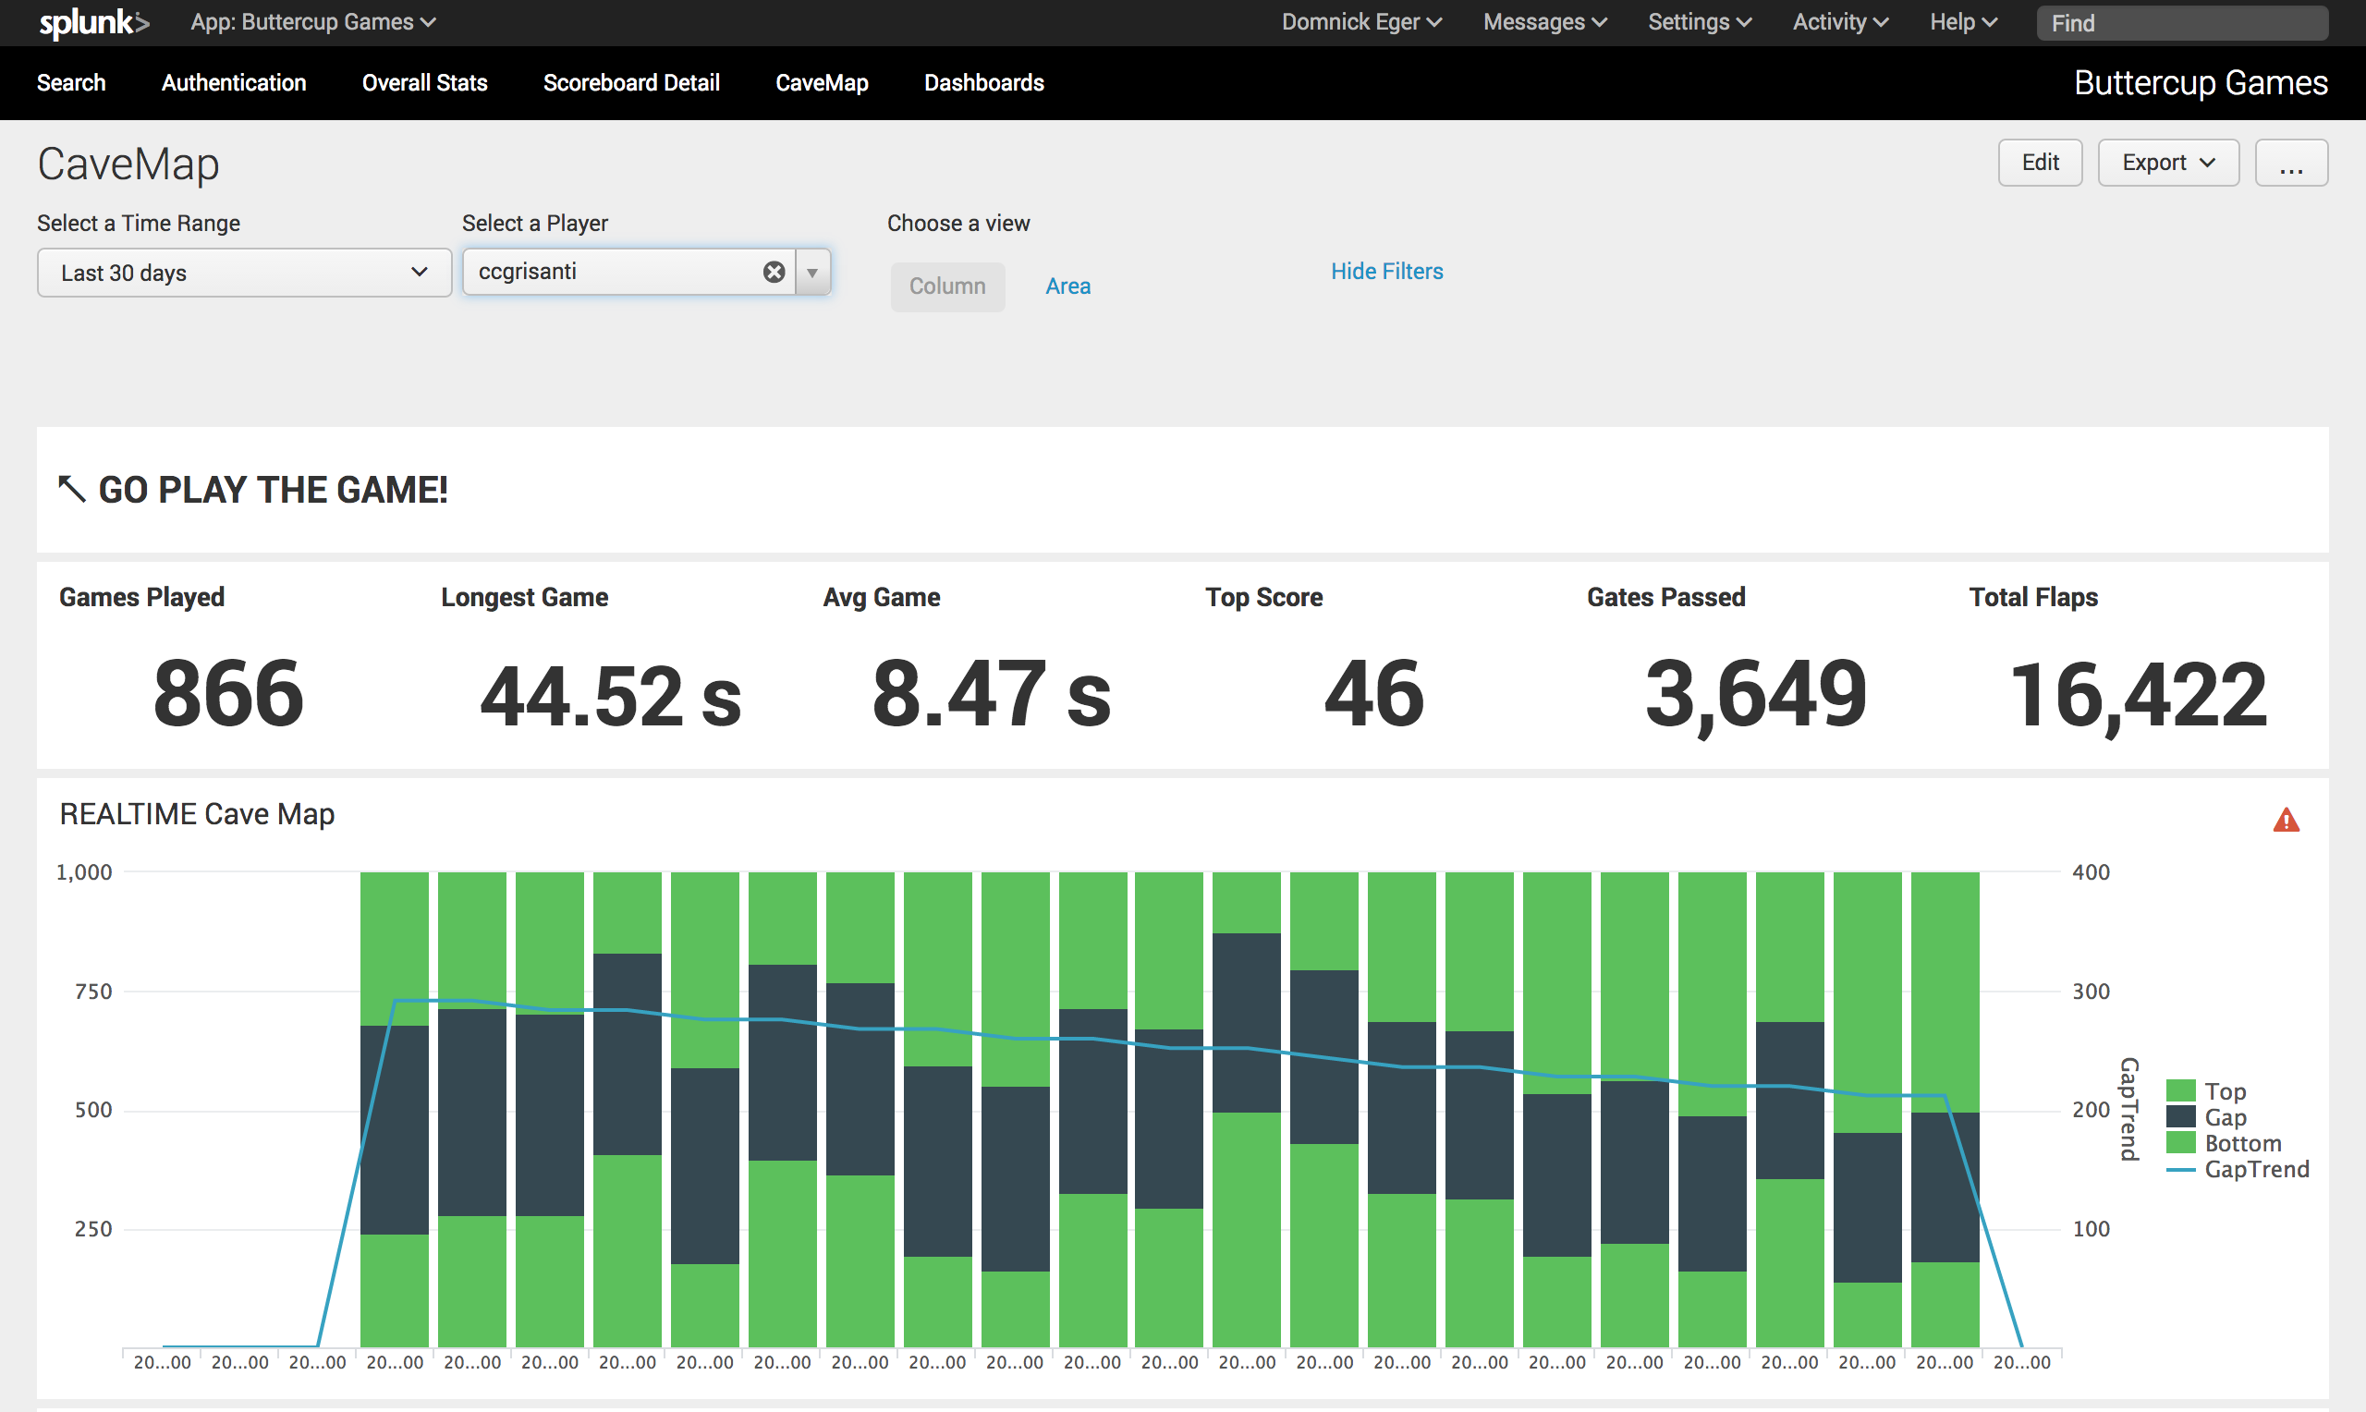
Dashboard Metrics for Fast Mode

Slide 49
Module 6: Adding an APM Tool – New Relic
Create a Git branch for the changes
Add the New Relic agent to your Buttercup-Go application
Add the New Relic javascript snippet to your Buttercup-Go application
Push your changes into the branch build. Test configuration by forcing Jenkins to kick off a build.
Test your changes by going to http://localhost:3040
Verify by logging into splunk and looking at the New Relic App http://localhost:8000/en-US/app/splunk_app_New_Relic/apm_overview

Slide 50
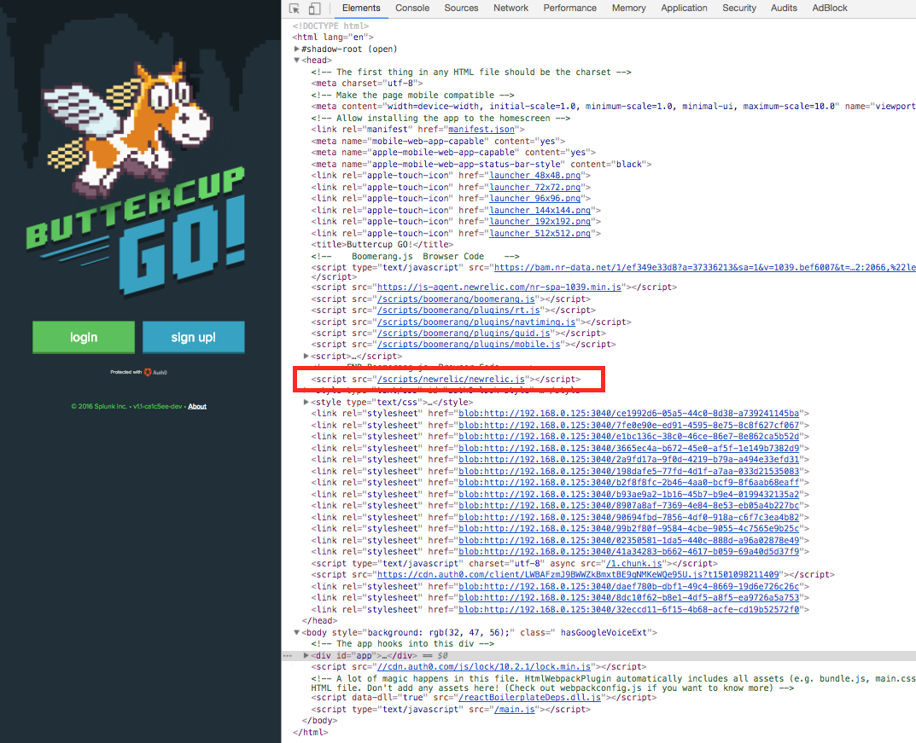
Before and After…

Slide 51
Module 7: Examing Gaming (Business) Metrics
Explore the various Splunk Applications (Jenkins, End User, New Relic, Buttercup Games)
Explore some of the searches behind the dashboards
Be sure to look at the Real Time Metrics also. How could
Create a new dashboard that correlates data from each source of data into a cohesive storyboard for Buttercup-Go.
Be Creative

Slide 52
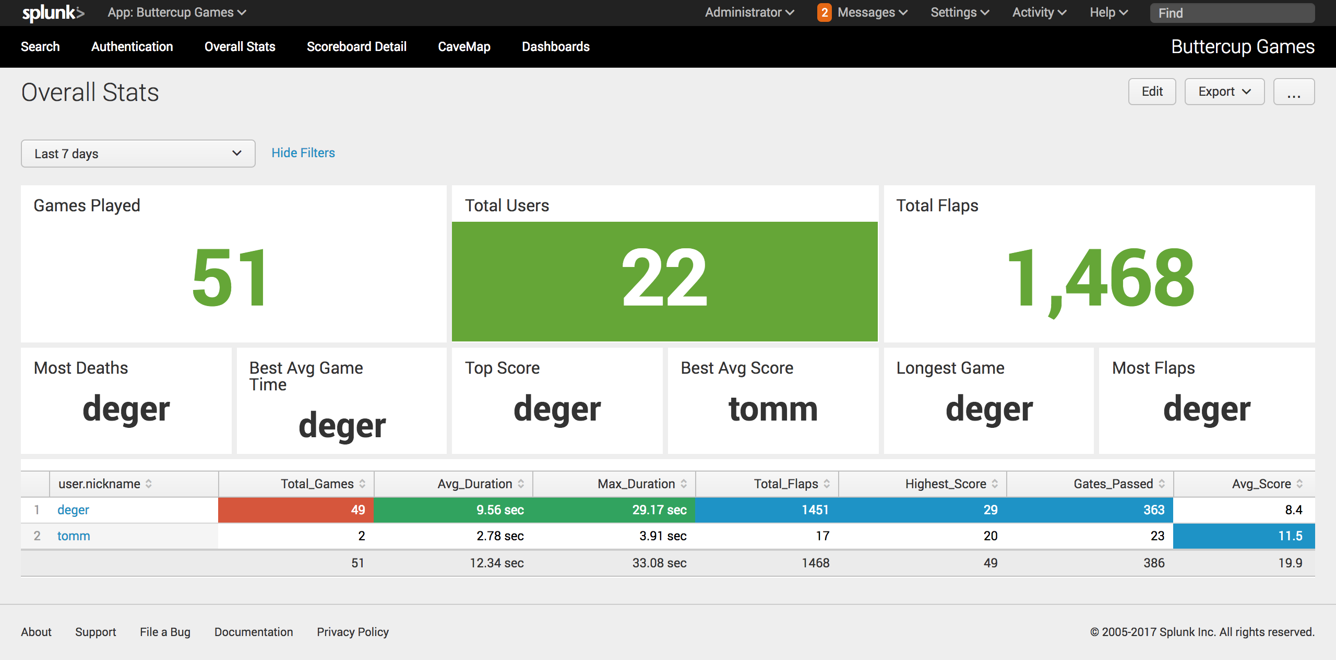
Module 7a: Real Time Metrics Collection
Login to Splunk and Click on Buttercup Games App & Explore

Slide 53
Wrapping Up…
Bringing it all together

Slide 54

Splunk with Modern Application Development
Dev (Commit)
Build
Test
Deploy
Run
Monitor
Business
$ git clone https://Splunk@bitbucket.buttercuplabs.win/scm/aw/buttercupgo-student02.git .
Cloning into '.'...
remote: Counting objects: 320, done.
remote: Compressing objects: 100% (297/297), done.
remote: Total 320 (delta 79), reused 204 (delta 9)
Receiving objects: 100% (320/320), 3.27 MiB | 1.02 MiB/s, done.
Resolving deltas: 100% (79/79), done.
$ git branch images
$ git checkout images
Switched to branch 'images'
$ git add *
$ git commit -m "making stuff up"

Slide 55
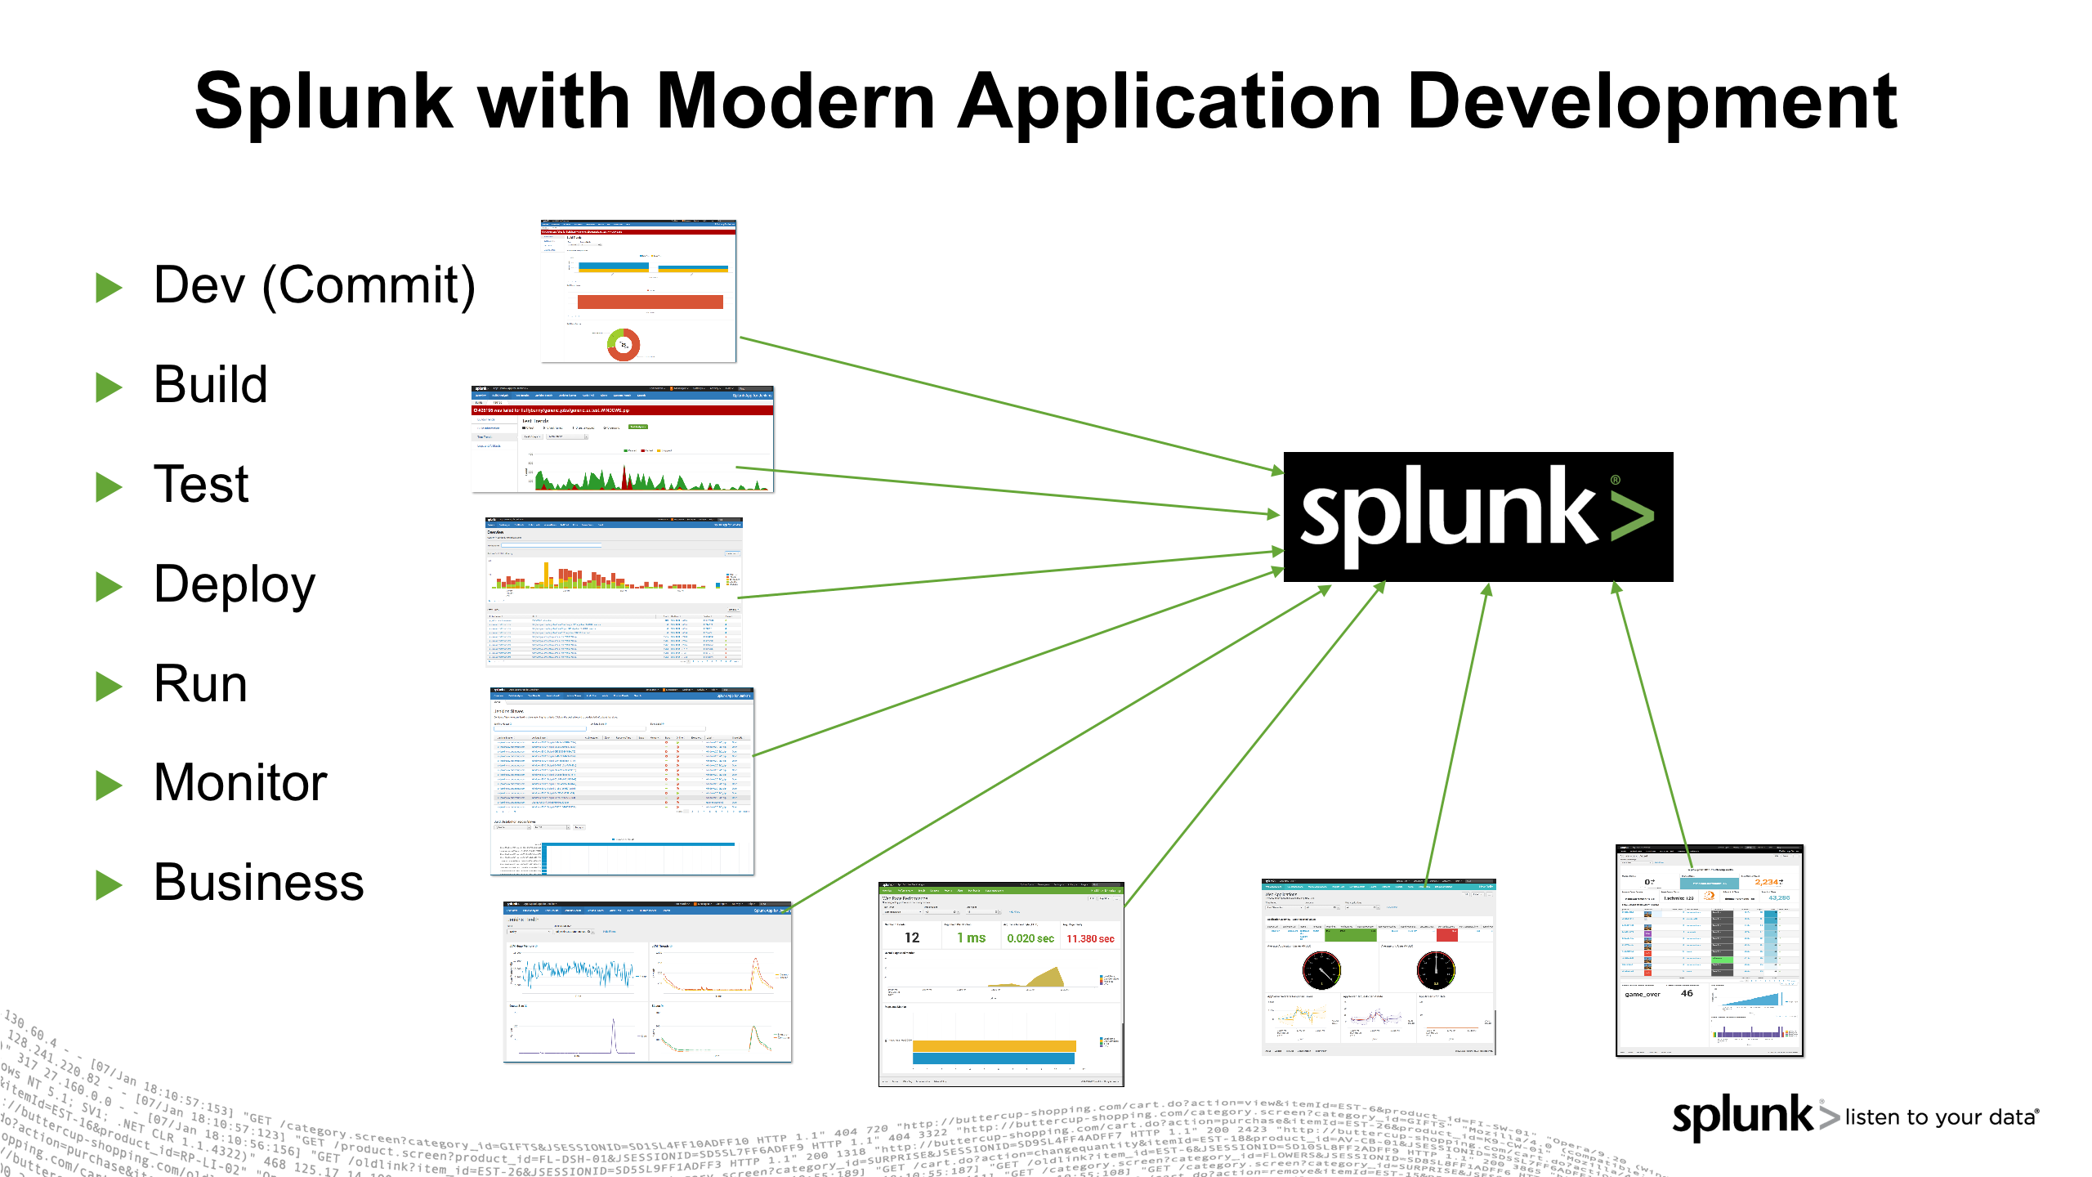
Visualize, Correlate, Search & Discover

Slide 56
Bringing It Together for Business & Users

Slide 57
Module 8: Take away from workshop
Feedback from this session
Goto https://www.surveymonkey.com/r/35LZ785
Please provide honest comments
Thank you for taking this DevOps journey with us. If you have any questions please feel free to contact us or contact your local sales team

